Slide 1
Austrian Economics
Hampered Market Economy:
Booms and Busts 1

Slide 2
Hampered Market Economy
Topic 1: Booms and Busts
Business Fluctuations
Change in underlying conditions
Profits and losses balance
Business Cycles
Cluster of profits in the boom
Cluster of losses in the bust

Slide 3
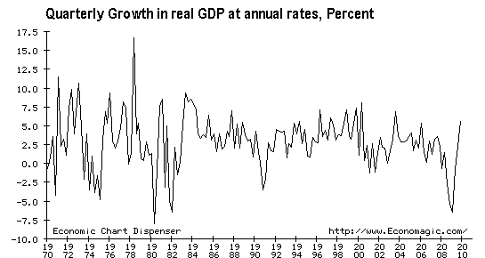
Hampered Market Economy
Topic 1: Booms and Busts
Business Cycle: ups and downs in economic activity

Slide 4
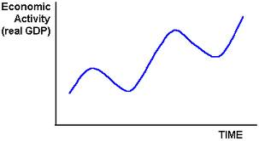
Hampered Market Economy
Topic 1: Booms and Busts
Phases of the Business Cycle
Crisis
Trend in Real GDP
Bust
Boom
Recovery

Slide 5
Hampered Market Economy
Topic 1: Booms and Busts
Phases of the Business Cycle
• Boom – Economic activity faster than trend
• Crisis – Upper turning point
• Bust – Economic activity slower than trend
• Recovery – Lower turning point

Slide 6
Hampered Market Economy
Topic 1: Booms and Busts
Features of the boom phase
• Output increases
• Unemployment declines
• Monetary inflation
• Credit expansion
• Low interest rates
• High capital values
• Modest price inflation

Slide 7
Hampered Market Economy
Topic 1: Booms and Busts
Features of the crisis phase
• Output plateaus
• Unemployment plateaus
• Monetary inflation slows or stops
• Credit expansion slows or stops
• Interest rates rise
• Capital values decline
• Price inflation increases

Slide 8
Hampered Market Economy
Topic 1: Booms and Busts
Features of the bust phase
• Output declines
• Unemployment increases
• Monetary deflation
• Credit contraction
• Interest rates are high and then decline
• Capital values fall and then rise
• Price deflation

Slide 9
Hampered Market Economy
Topic 1: Booms and Busts
Features of the recovery phase
• Output increases normally
• Unemployment returns to a normal level
• Neither monetary inflation nor deflation
• Neither credit expansion nor contraction
• Interest rates return to normal levels
• Capital values increase normally
• Neither price inflation nor deflation

