Slide 1
Austrian Economics
Economics

Slide 2
Economic Law
Law
• Rule that regulates some activity
• Applies universally
Types of law
Laws of nature
Moral law

Slide 3
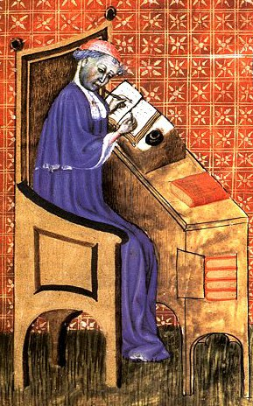
First Treatise on an Economic Topic
Nicole Oresme
(1323-1382)
• Student at U. of Paris
• Teacher at the College of Navarre
• Treatise on the Origin, Nature, Law, and Alterations of Money

Slide 4
Economic Law
Types of Laws
• Laws of Nature
Scientific
Statistical
• Laws of Human Behavior
Moral
Praxeological

Slide 5
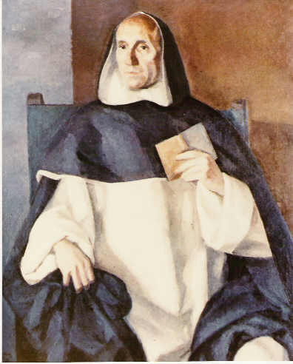
School of Salamanca
Francisco de Vitoria
(1492-1546)
• Founder of the School of Salamanca
• Laws of Politics

Slide 6
School of Salamanca
Social Conditions in 16th Century Spain
• Political: Enslavement of natives
Natural rights
• Economic: Monetary inflation
Economic laws

Slide 7
Economic Law
Economic Laws – School of Salamanca
1. Larger stock of money, lower PPM
• Case of a universal law
• Not quantitatively definite
• Non-neutrality of money
2. Law of one price
• Arbitrage and competition
• PPP theory

Slide 8
Economic Law
Distinctions between Types of Law
1. Laws of nature
• Descriptive
• Start with observable facts
• Discover by empirical experiments
2. Moral law
•Prescriptive
• Start with reflective facts
• Discover by reason and revelation

Slide 9
Economic Law
Distinctions between Types of Laws
3. Economic laws
• Descriptive
• Start with reflective facts
• Discover by reason

Slide 10
Economics – Three Branches
Economic Theory
• Universal, abstract knowledge of human action
• Method of inquiry: Praxeology
Economic History
• Blend economic theory with specific, concrete
knowledge of human action
• Judgment of relevance
Applied Economics
• Theoretical knowledge of particular cases
• Theory tailored to circumstances

