Slide 1
Western Civilization Since 1500
Lecture 41: Globalism and the European Union

Slide 2
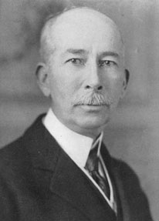
Globalist Agenda
One-World Vision
Wilsonian Program
  Edward M. House
  League of Nations
Rejuvenation in WWII
  Moscow Declaration
  Dumbarton Oaks Conference

Slide 3
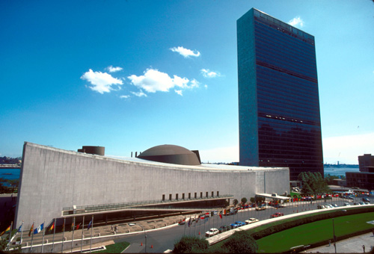
United Nations
1945 Charter
  Claims precedence over other treaties
  Claims authority in international disputes and some domestic affairs
Structure
  General Assembly
  Security Council

Slide 4

U.N. Interventions
1950—Korea
1960—Katanga
1973-74—Suez, Golan Heights
1990—Iraq
1990s—Yugoslavia
2004—Ivory Coast

Slide 5
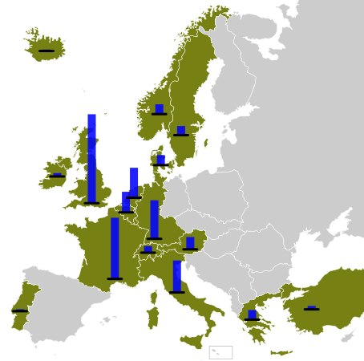
Towards European Government
Marshall Plan
1951—European Coal and Steel Community
1957—European Atomic Energy Community
1957—European Economic Community

Slide 6
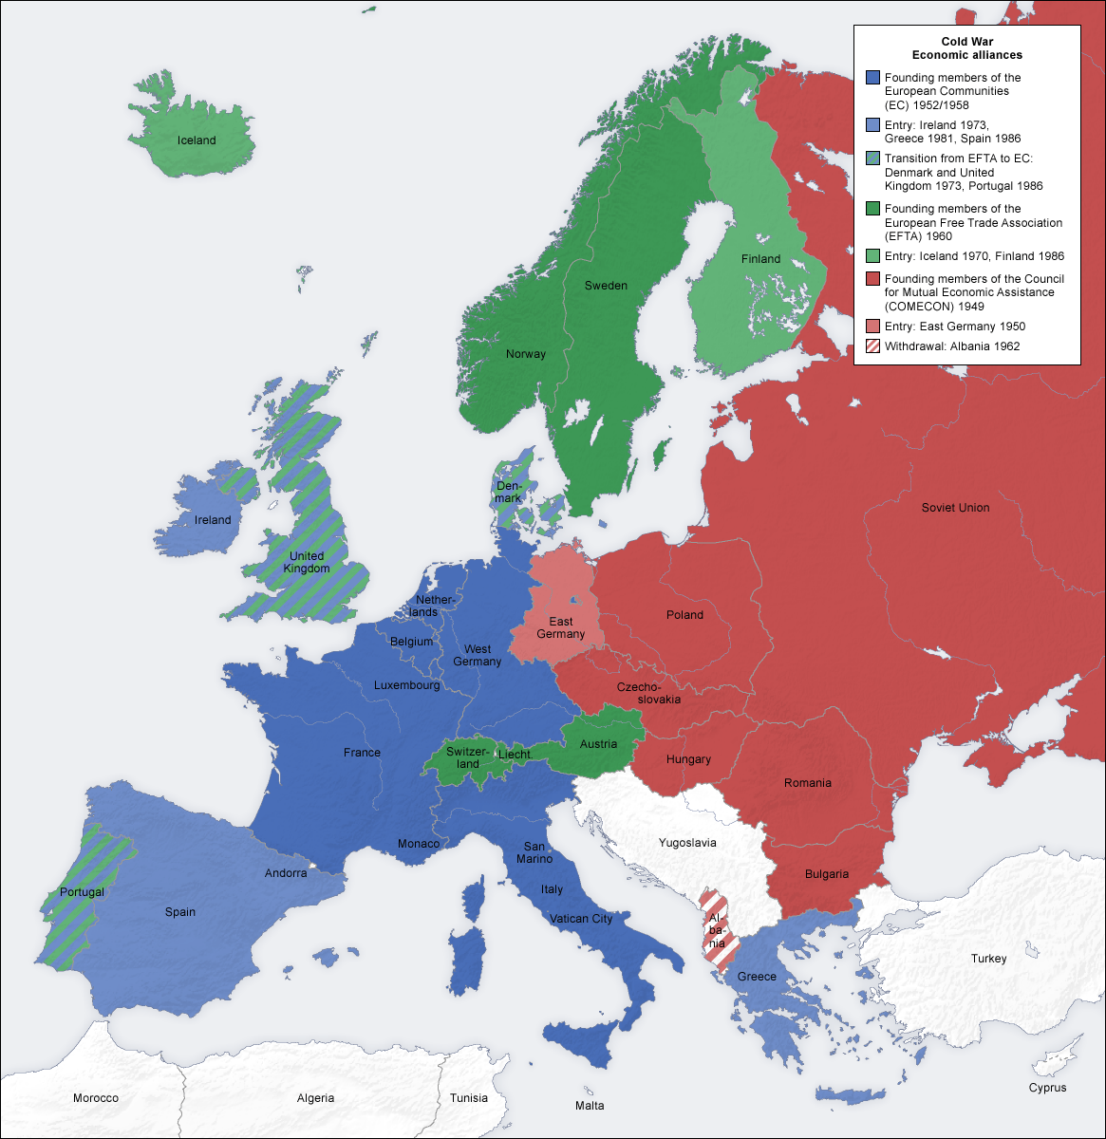
Towards European Government
1973—European Community
Gradual expansion
1986—Single Europe Act
1992—Maastricht Treaty
1994—European Union

Slide 7
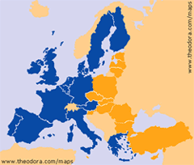
Towards European Government
1999—European Central Bank
2004—Ten countries added
2005—Constitution (failed)
2009—Lisbon Treaty

