Slide 1
Western Civilization since 1500
Lecture 40: Cold War II

Slide 2
Nuclear Arms Race
Manhattan Project
Espionage
  CIA vs. KGB
  Julius and Ethel Rosenberg
1953—Hydrogen bomb developed
Nuclear Politics
  “Massive Retaliation”
  “Missile gap” and U2 incident
1962—Cuban Missile Crisis
1963—Nuclear Test-Ban Treaty
“Mutual Assured Destruction”

Slide 3
Detente
Easing of tensions in 1970s
  Economic troubles
  Soviets vs. Chinese
1972—SALT I
Russian view of Watergate
Discussion shifts toward human rights under Ford and Carter

Slide 4
Hostility Resumes
1979—a critical year
  SALT II falls through
  Soviets invade Afghanistan
  Iranian Revolution
    Ayatollah Khomeini
    Hostage crisis
Ronald Reagan and election of 1980
  Strategy of resuming arms race
  Strategic Defense Initiative (SDI)—”Star Wars”

Slide 5
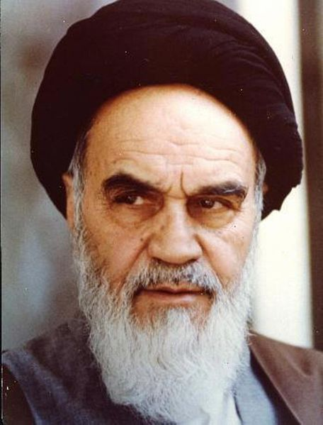
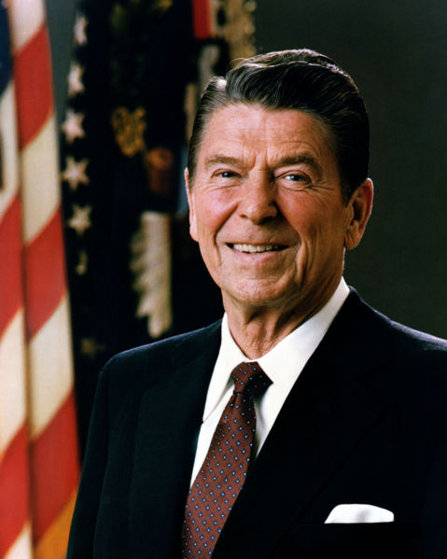

Slide 6
Liberation of Eastern Europe
Brezhnev Doctrine
Poland—Lech Walesa and Solidarity
1985—Mikhail Gorbachev assumes power in USSR, vows relaxation in Eastern Europe
Hungary opens borders
1989—year of liberation
  Berlin Wall comes down
  Communist governments everywhere collapse
  Reunification of Germany in 1990

Slide 7
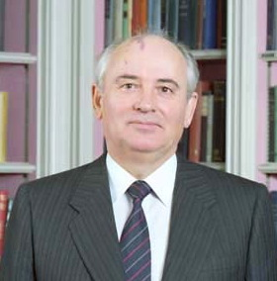
Collapse of USSR
Gorbachev’s vision
  Glasnost—”openness”
  Perestroika—”restructuring”
Crisis of consumer culture
Issue of nationalism
1990—Baltic states break away
August 1991—hardliner coup fails
December 1991—USSR breaks up

