Slide 1
Western civilization since 1500
Lecture 39: Cold War I

Slide 2
Post-WWII Europe
Territorial changes
  Poland moved west
  Germany and Austria separated
  Soviet annexations
Economic devastation
Soviet sphere of influence: “Iron Curtain”
Marshall Plan (1947-1952)
  Free money?
  Soviet satellites refused aid

Slide 3
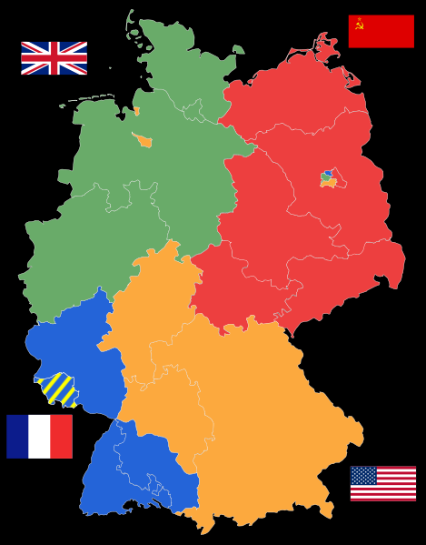
Germany
Vienna or Versailles?
Western merger, Soviet isolation
Conflict over new currency, status of Berlin

Slide 4
Divided Germany
Berlin Airlift (1948-1949)
New governments in 1949
  Federal Republic of Germany (FRG)
    Parliamentary democracy
    Eventual free-market system
  German Democratic Republic (DDR)
    Communist
    Kept in power by Soviet army

Slide 5
Containment
George Kennan
  “Long Telegram” (1946)
  Urged proactive American policy
1949—formation of NATO
1955—formation of Warsaw Pact
Yugoslavia and Marshal Tito

Slide 6
Post-Stalin Russia
1953—Stalin dies
1956—Twentieth Party Congress
  Nikita Khrushchev
  Stalinist terrors denounced; “De-Stalinization”
Russia in Eastern Europe
  1956—Khrushchev crushes Hungarian protest
  1968—Leonid Brezhnev crushes “Prague Spring”
1961—Berlin Wall

Slide 7
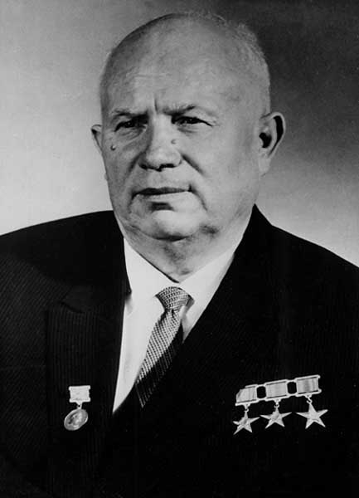
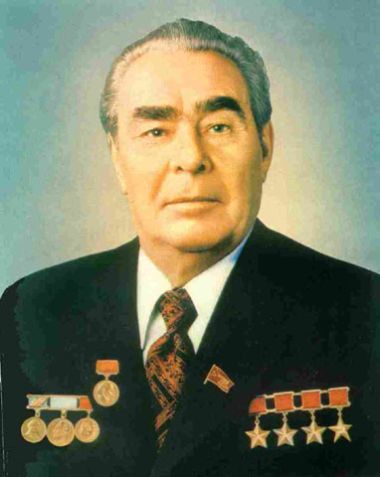
Soviet Leaders

