Slide 1
Western Civilization since 1500
Lecture 37: Fascism and the Road to World War II

Slide 2
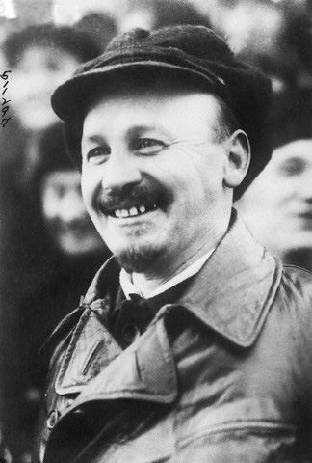
Russia, 1919-1939
Civil War
  Reds vs. Whites
  Western intervention
Soviet Government
  Centralization
  Central Committee
  Politburo (Lenin, Trotsky, Bukharin, Stalin)

Slide 3
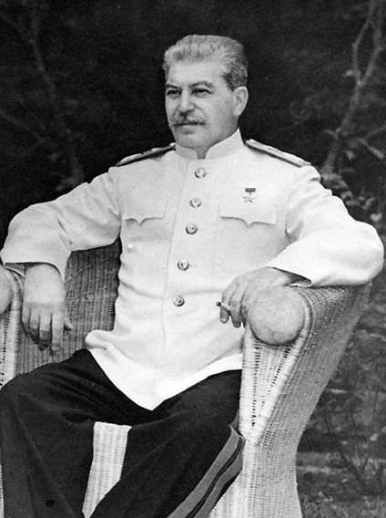
Russia, 1919-1939
“War Communism”
New Economic Policy, 1921-1928
  Bukharin’s idea
  Market reforms to boost agriculture
Stalin in control
  Five-Year Plans
  Purges

Slide 4
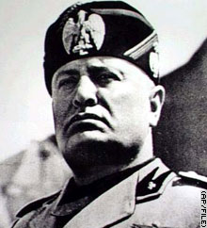
Rise of Fascism
Fasces
Elements of socialism economically
Elements of conservatism culturally
Ultranationalist
Unapologetic celebration of force

Slide 5
Italy
Benito Mussolini (1883-1945)
Fascist Party
  Anti-Bolshevik
  Anticapitalist
1922—”March on Rome”
1925—One-party State
1930s—imperial pursuits

Slide 6
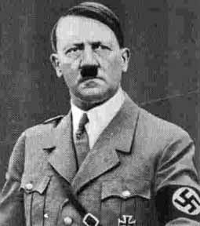
Germany
Adolf Hitler (1889-1945)
National Socialist Party
Beer Hall Putsch
1933 elections
SA➔Army
Goals: Lebensraum, rearmament, autarky

Slide 7
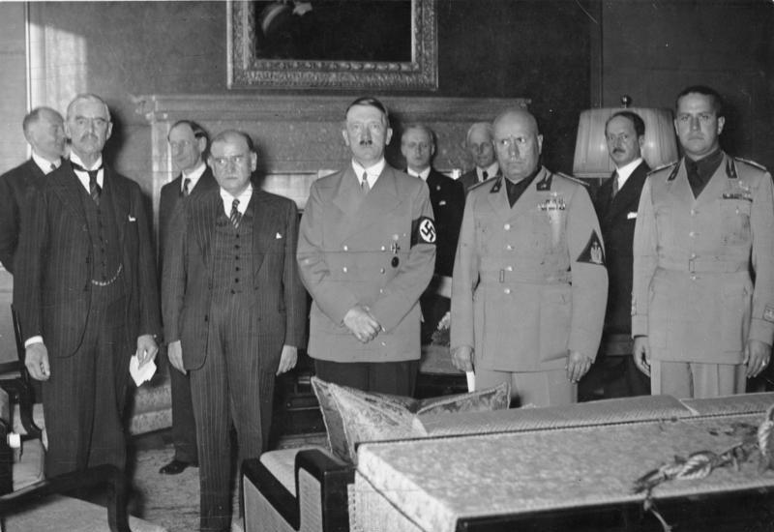
Road to War
1936—Rhineland
1936-1939—Spanish Civil War
1938—Anschluss
1938—Sudetenland
Munich Conference
  Neville Chamberlain
  Édouard Daladier

Slide 8
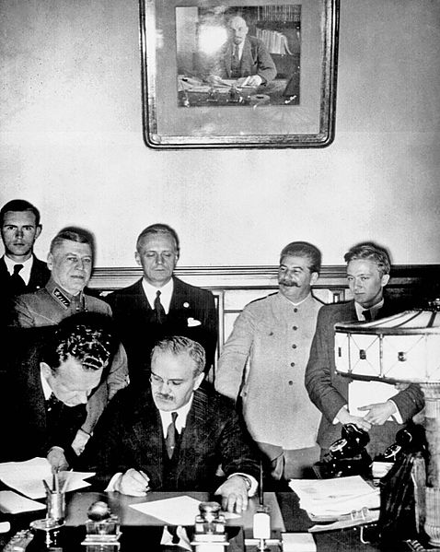
Road to War: 1939
3/15—Czechoslovakia
4/7—Albania
4/28—Cancels Treaty with Poland
5/22—Pact of Steel
8/23—Nazi-Soviet Non-Aggression Pact
9/1—Invasion of Poland

