Slide 1
Western Civilization since 1500
Lecture 36: Interwar Europe

Slide 2
Postwar Situation
European autonomy and predominance are gone
Economic difficulties
  Prewar investments gone or liquidated
  Debt burdens and reparations
  Unemployment
Civil unrest: Hungary, Germany, Italy, etc.

Slide 3
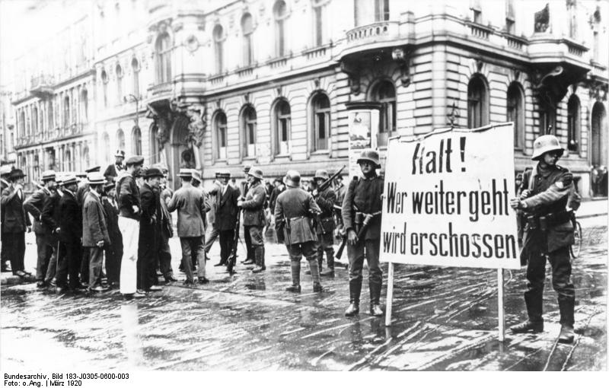
Weimar Germany
Constitutional revolution (11/1918)
  Erich Ludendorff
  Mutinies, protests
  Wilhelm II abdicates
“Stabbed in the back”
“Spartacists”
Kapp Putsch (1920)
Treaty of Rapallo (1922)

Slide 4
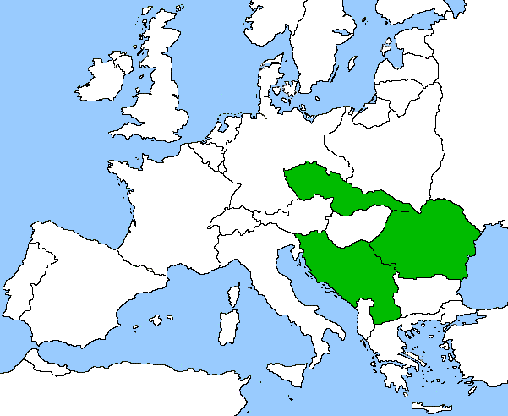
New Alliances
U.S. and Britain step back
France seeks help from new states
  Poland
  “Little Entente”
  Ineffective substitute for prewar alliance with Russia

Slide 5
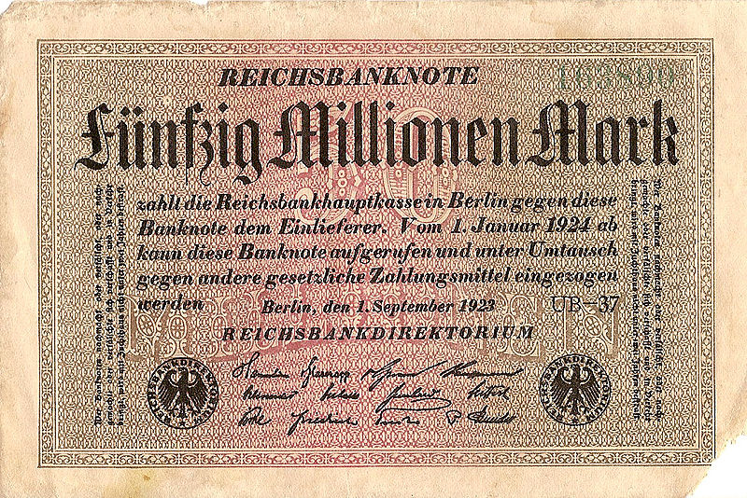
Ruhr Crisis
12/1922—Germany misses payment
1/1923—France invokes Versailles, occupies Ruhr
Passive resistance
Hyperinflation
Riots, attempted revolutions

Slide 6
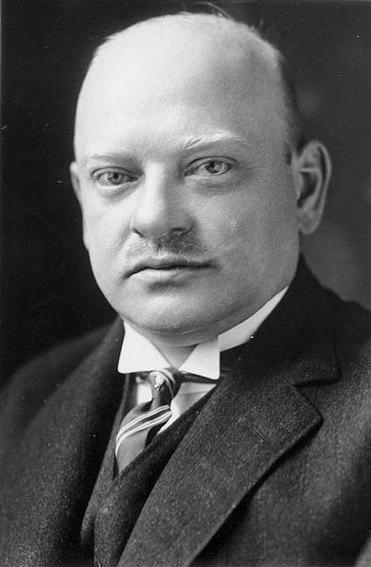
Conciliation, 1924-1929
Gustav Stresemann
  Abide by Versailles in West
  Revise Versailles in East
Dawes Plan (1924)
Locarno Agreements (1925)
Kellogg-Briand Pact (1928)

Slide 7
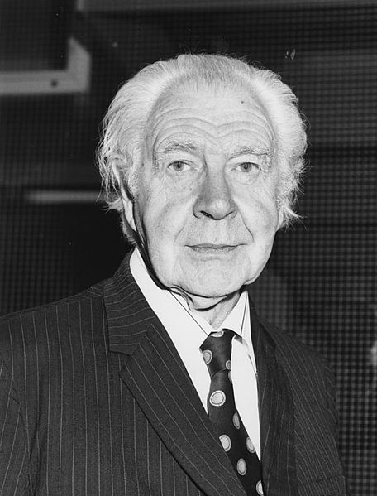
Depression in Europe
Cause: Austrian Business Cycle Theory
Trade barriers rose
American bankers
  Stopped lending
  Wanted continued payments
Gold standards abandoned (again)

