Slide 1
Western Civilization Since 1500
Lecture 35: Paris Peace Conference

Slide 2
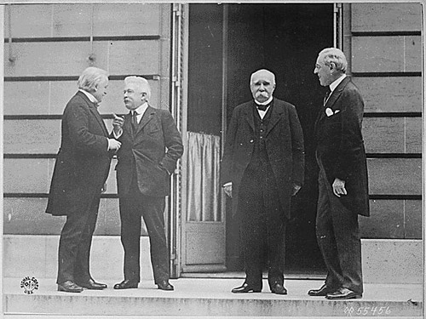
Paris Peace Conference
January-June, 1919
Goal of a new international order
Big Four
  Wilson (USA)
  Lloyd George (UK)
  Clemenceau (France)
  Orlando (Italy)

Slide 3
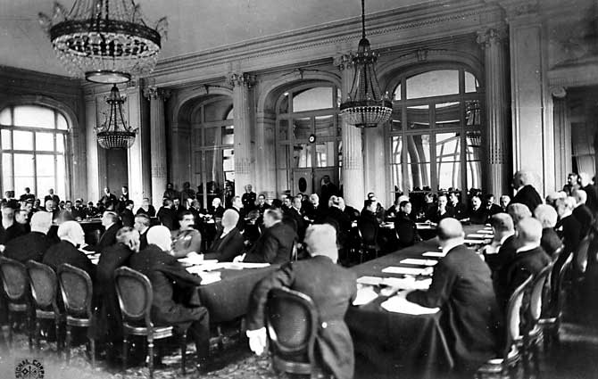
Objectives
Idealism (Fourteen Points)
  Open treaties
  “Freedom of seas”
  Self-determination
  League of Nations
Interest
  Reparations
  Secret agreements
  Concern over Bolshevism
Interest wins

Slide 4
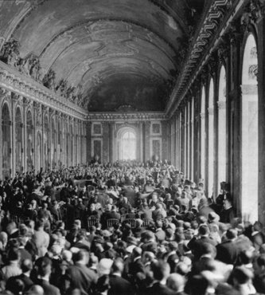
Germany: Treaty of Versailles
No German input
Article 231: “war guilt clause”
Article 232: Germany pays reparations
France gains
  Alsace-Lorraine
  Saar coal mines

Slide 5
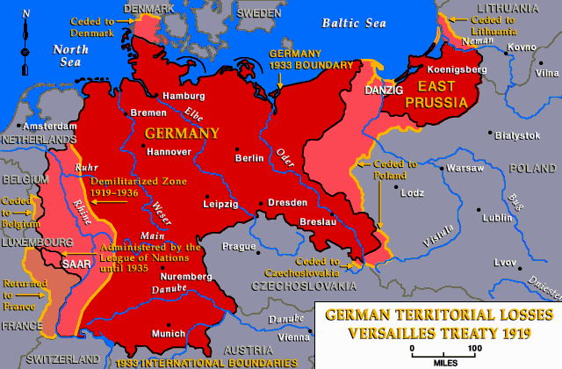
Germany: Treaty of Versailles
Rhineland demilitarized
Eastern territorial concessions (to Poland)
  Land gained from Brest-Litovsk
  Danzig and environs
Overall, Germany shrinks 10%

Slide 6
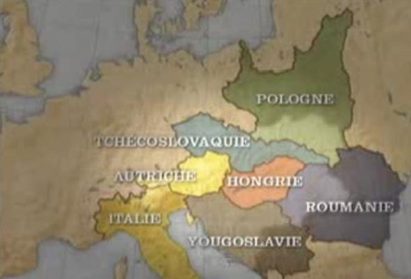
Austria-Hungary
Treaties of St. Germain and Trianon
Empire dismembered, Habsburgs out
Hungary independent
Austria forbidden from joining Germany
“Czechoslovakia”
“Yugoslavia”

Slide 7
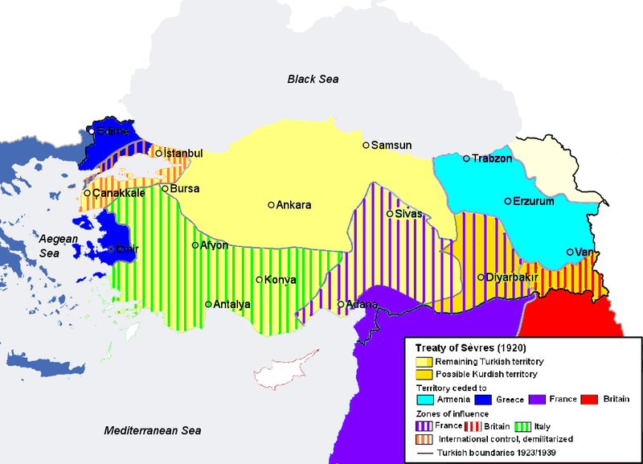
Ottoman Empire
Treaty of Sèvres
Empire dismembered
Non-Turkish areas become “League Mandates”
Turks left with most of Anatolia, some to Greece and Armenia

Slide 8
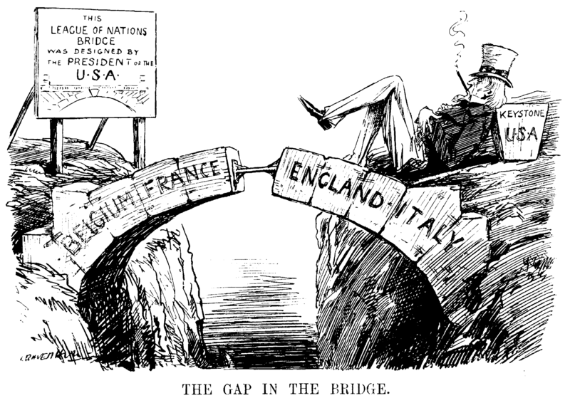
League of Nations
Created in Treaty of Versailles
Principles
  Respect territorial integrity of member states
  Submit disputes to arbitration
  Colonies put under “tutelage”
  Calls for disarmament
Britain and France dominate

