Slide 1
Western Civilization Since 1500
Lecture 33: World War I

Slide 2
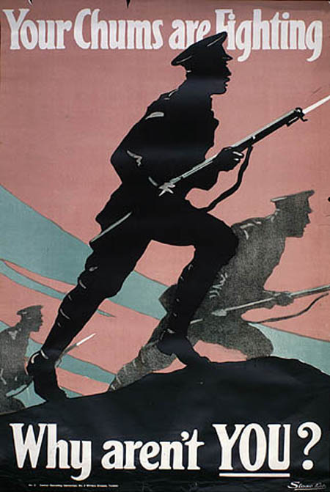
Outbreak of War
Austria has pretext to attack Serbia
Russia backs Serbia, alliance systems triggered
  Italy stays out
  Britain comes in
  Ottoman Empire
“Home by Christmas”

Slide 3
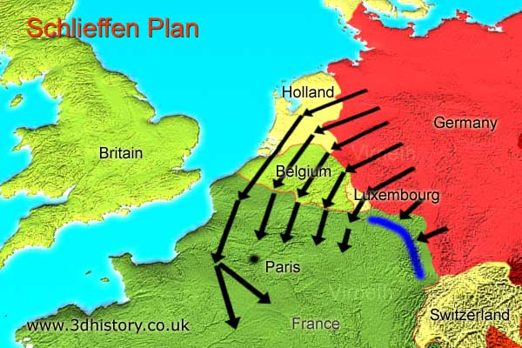
Summer 1914
Schlieffen Plan
  France, then Russia
  March through Belgium
French Plan XVII
Tannenberg and Masurian Lakes
Battle of the Marne
Entrenchment

Slide 4
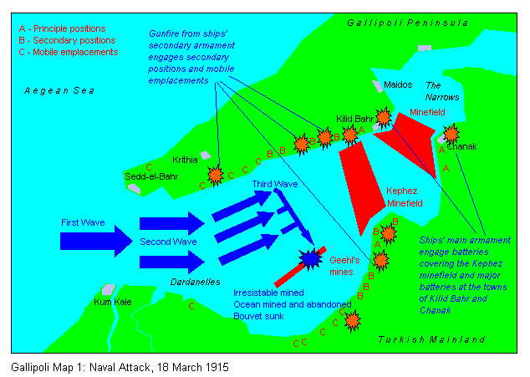
Stalemate
Piling in
  Japan
  Italy
  Balkan states
Gallipoli campaign
  Winston Churchill
  1st big amphibious invasion
  Complete failure
Egypt, Mesopotamia

Slide 5
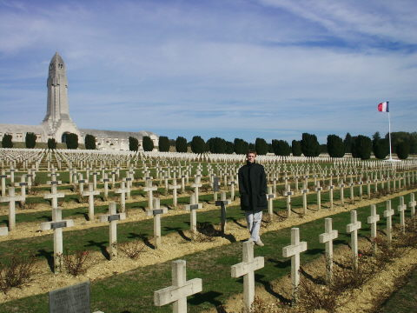
Stalemate
Verdun and the Somme (1916)
  Tactics not adjusted to technology
  “Bleed dry” strategy
  Huge losses
Eastern front the only mobile one

Slide 6
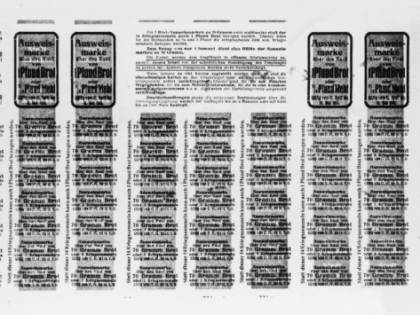
Turning Point
Missed opportunity for peace, 1916-1917
Growing dissent, rationing
Russian Revolution
U.S. entry (April 1917)
Ludendorff Offensive (1918) fails
Armistice 11/11/1918

