Slide 1
Western Civilization Since 1500
Lecture 32: World War I: Beginnings

Slide 2
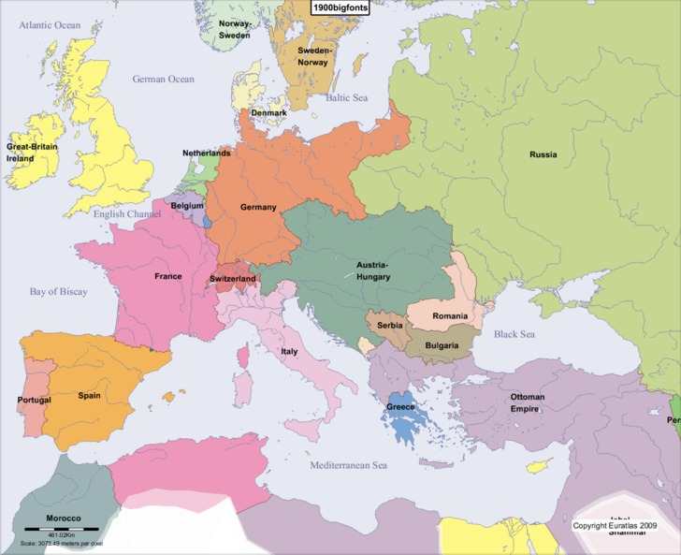
Great Power Insecurity, 1870-1914
British fear Germany
French diplomatic isolation
Austria-Hungary’s nationalities
Russia wants warm-water port
Germany fears encirclement
Rivalries

Slide 3
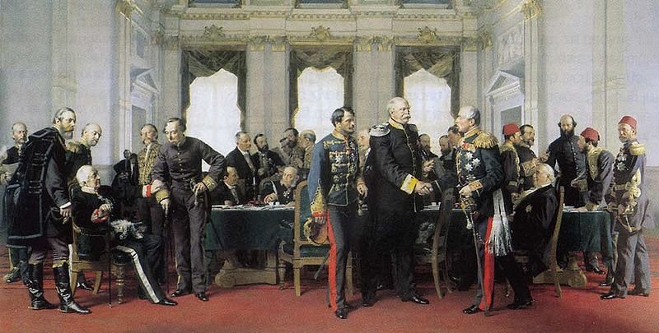
Concert of Europe
Dreikaiserbund
Balkan Crisis (1875-1878)
  Russia aids Slavic rebellion vs. Ottomans
  Treaty of San Stefano
  Congress of Berlin
Concert’s last success

Slide 4
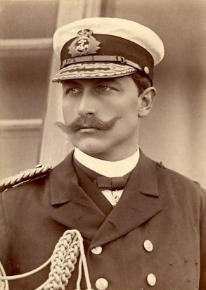
New Alliance System
Bismarck hedges
  Dual Alliance
  Triple Alliance
  Reinsurance Treaty
Diplomatic Revolution
  Wilhelm II
  Anglo-French reconciliation
  Triple Entente

Slide 5
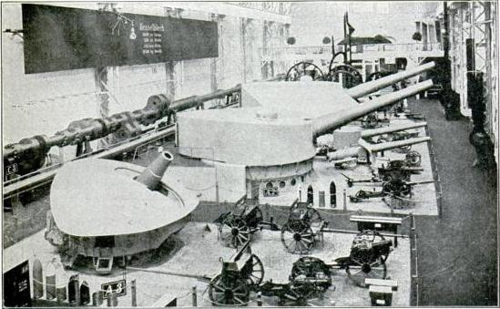
Dangers of New System
Reckless members drive agenda
  Austria-Hungary
  Russia
Arms race
Military gains greater role in policymaking

Slide 6
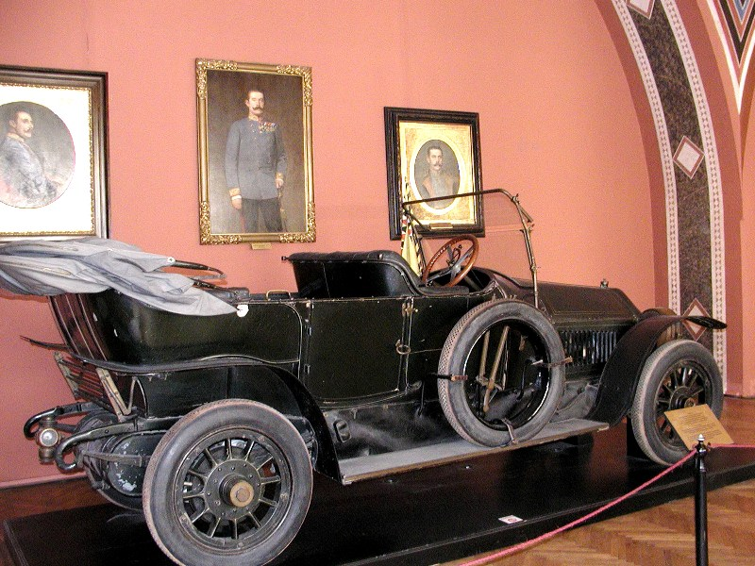
Road to War
1908—Austria-Hungary annexes Bosnia and Herzogovina
1911—Second Moroccan Crisis
1912-1913—First & Second Balkan Wars
1914—Assassination of Archduke Franz Ferdinand

