Slide 1
Western Civilization Since 1500
Lecture 31: Imperialism

Slide 2
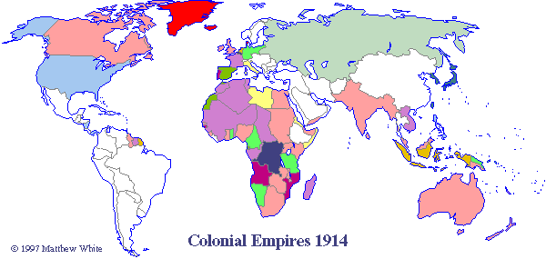
European Imperialism
Not a new phenomenon
Scale was unprecedented
  Industrialized world dominated non-industrialized world
  Great Powers (and not-so-great powers)

Slide 3
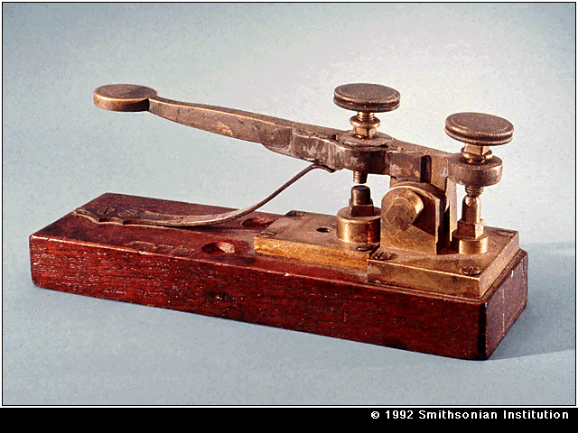
How?
Transportation (esp. steamship)
Communications (esp. telegraph)
Medicine (esp. quinine)
Weaponry

Slide 4
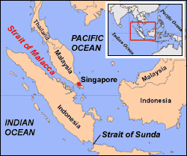
Why?
Economic motives
Geopolitical considerations
  “Buffer” areas
  Navies grow
Nationalism
  Jingoism
  Social Darwinism

Slide 5
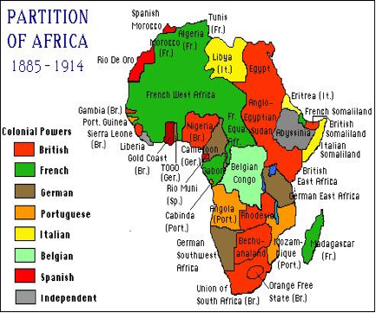
Regions: Africa
Most direct involvement
Berlin Conference (1884) and “Scramble for Africa”
Dutch settler society and the Boer War (1899-1902)

Slide 6
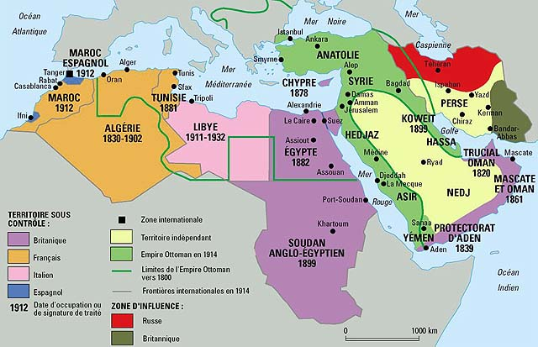
Regions: Middle East
Ottoman Empire—”sick man of Europe”
Russian encroachment
British and French involvement from 1830s
Tanzimat movement

Slide 7
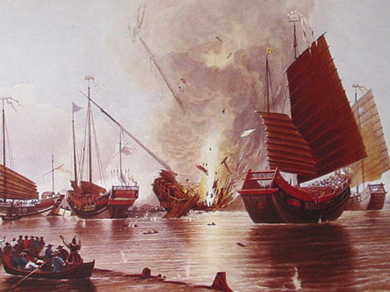
Regions: Far East
Economic motive
British in India
  East India Company
  Sepoy Mutiny (1857)
  “Great Game”
Europe in China
  Opium Wars
  Revolts against Qing

Slide 8
Effects of Imperialism
Increase in foreign trade, foreign investment
Greater efficiency in world markets, rising standards of living
Large-scale Christian missions efforts
Destruction of traditional cultures, distortions of some colonial economies
Critiques: Gooch, Hobson, Lenin

