Slide 1
Western Civilization Since 1500
Lesson 30: Modernism

Slide 2
Irrationalism
Reaction against much Enlightenment philosophy
Argued that Man’s fundamental impulses are irrational
If this is true, then what?
  Celebrate the irrational OR
  Try to contain it

Slide 3
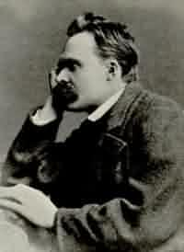
Friedrich Nietzsche (1844-1900)
Prussian-born, professor at Basel
Intermittent bouts of insanity until final collapse in 1890s
Life is not rational—embrace it
Beyond Good and Evil
Thus Spoke Zarathustra

Slide 4
Friedrich Nietzsche (1844-1900)
Most consistent modern rejection of Christianity
  “God is dead”—nihilism
  Christian morality must be discarded
  Christianity has weakened European race

Slide 5
Friedrich Nietzsche (1844-1900)
The “superman” (übermensch)
  Creates his own values
  Frees himself from democracy
  Not ashamed of the “will to power”
  Must save Europe

Slide 6
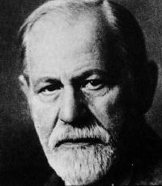
Sigmund Freud (1856-1939)
Believed unconscious urges determine conscious thoughts
Use reason, science to control the irrational
The Interpretation of Dreams
Civilization and Its Discontents

Slide 7
Sigmund Freud (1856-1939)
Father of psychoanalysis
Did case studies of neurotics
Neuroses are traceable to childhood and usually sexual in nature (Oedipus complex, etc.)

Slide 8
Sigmund Freud (1856-1939)
Id—subconscious source of instincts, appetites
Ego—reason, restrains id to make social life possible
Superego—conscience, opposed to id (paternal)

Slide 9
Sociologists
Emile Durkheim (1858-1917)
  Positivist like Comte
  Problem of anomie in modern world
  Hoped unions, associations would cure alienation
Vilfredo Pareto (1848-1923)
  Social behavior is irrational; suspect everyone
  Two kinds of people: elites and masses
  “80/20 rule”
  Opponent of democracy, prophesied new leaders

Slide 10
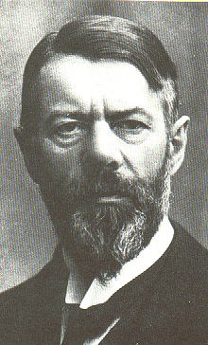
Sociologists
Max Weber (1864-1920)
Why is the West rational while others aren’t?
Answer: religion, esp. Protestantism
“Weber Thesis”

