Slide 1
Western Civilization Since 1500
Lecture 29: Politics 1870-1914

Slide 2
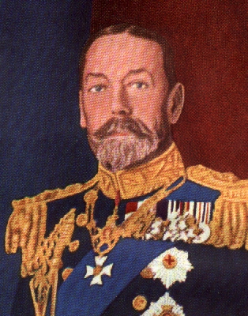
Great Britain
Increasing suffrage
  Benjamin Disraeli vs. William Gladstone
  Women’s suffrage after World War I
Formation of Labour Party (1893)
Parliament Act of 1911

Slide 3
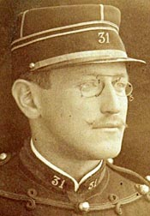
France
Third Republic (1870-1940)
  Began when Napoleon III was captured
  Not popular
Scandals
  Boulanger Affair
  Panama Affair
  Dreyfus Affair

Slide 4
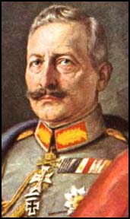
Germany
Second Reich (1870-1918)
Bismarck and Kulturkampf
Ferdinand LaSalle & Social Democrats
Kaiser Wilhelm II (1889-1918)

Slide 5
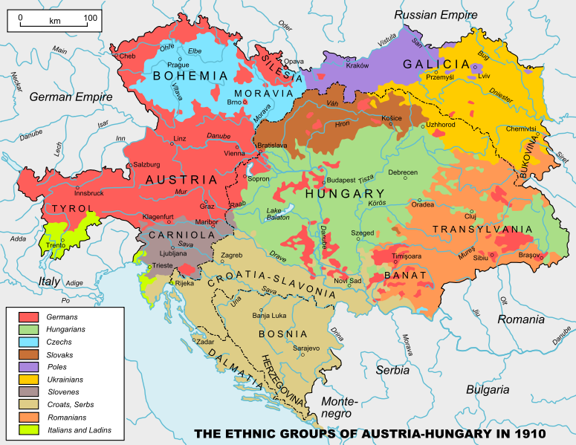
Austria-Hungary
Political and economic liberalization
Vienna as a cultural capital
Continuing ethnic tension

Slide 6
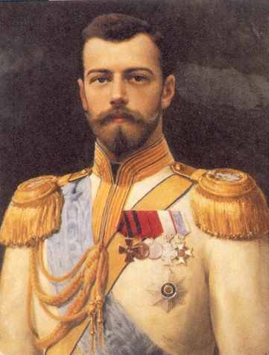
Russia
Alexander III (1881-1894) and insularity
Nicholas II (1894-1917)
  Russo-Japanese War
  Revolution of 1905

