Slide 1
Western Civilization Since 1500
Lecture 28: Second Industrial Revolution

Slide 2
“Second Industrial Revolution”
Period ca. 1850s-1914
Extension of industrial and transportation networks
Numerous technological advances

Slide 3
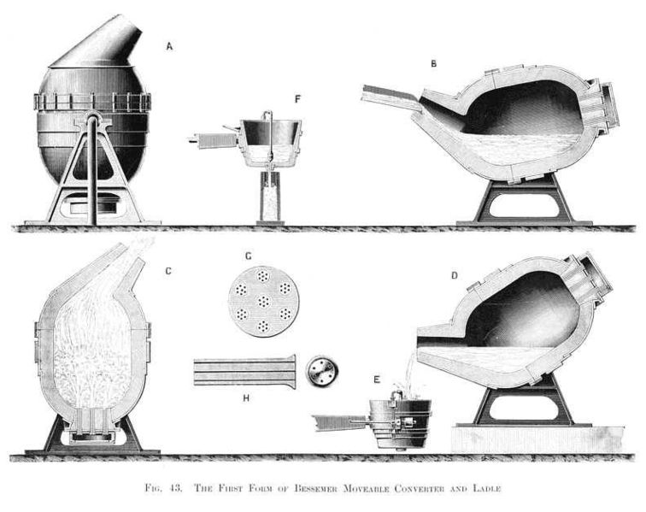
Manufacturing
Bessemer steel
“American system”
  Interchangeable parts
  Machine tools
Scientific management
Chemicals industry

Slide 4
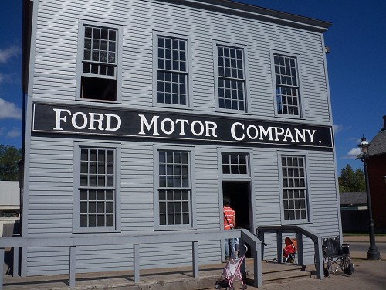
Manufacturing
Petroleum industry
  Kerosene
  Gasoline
Electrification
  Lighting
  Power for industry
Automobile
  Benz, Ford
  Assembly line

Slide 5
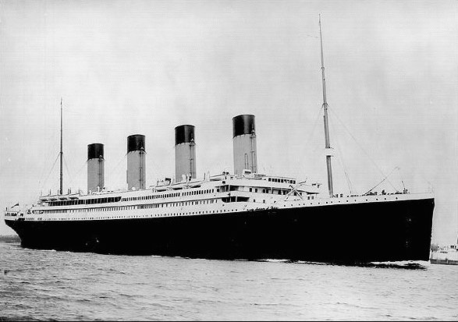
Transportation Networks
Steamships
  Robert Fulton
  Transoceanic routes
Railroad extension with steel rails
Hard-surfaced roads
  John Loudon Macadam
  Bicycles, autos

Slide 6
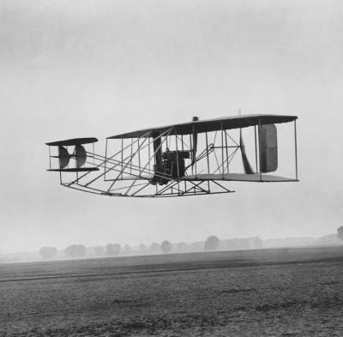
Other Innovations
Telephone
Radio
Airplane

Slide 7
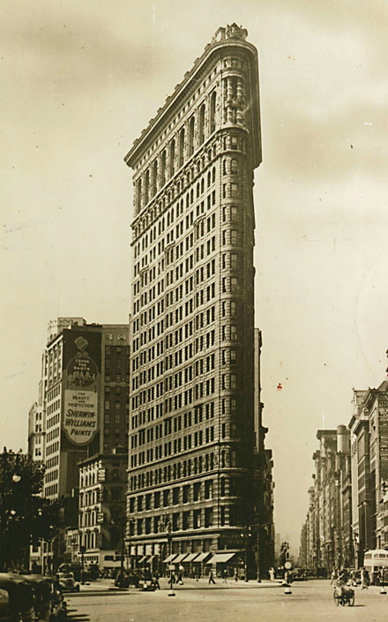
Urbanization
Accelerated rate
Transportation infrastructure
High-rises
Labor for factories
Problems of sanitation, health, sanity

Slide 8
Results
Concentration of wealth
  Large firms
  Corporations
  Banks
Standardization
Growing political involvement of businesses and labor

