Slide 1
Western Civilization Since 1500
Lecture 27: Politics, 1848-1870

Slide 2
Review
Conservative governments, 1815-1830
  Concert of Europe
  Traditional order upheld domestically
Some liberal advances, 1830-1848
  July Revolution
  Great Reform Bill
Revolutions of 1848

Slide 3
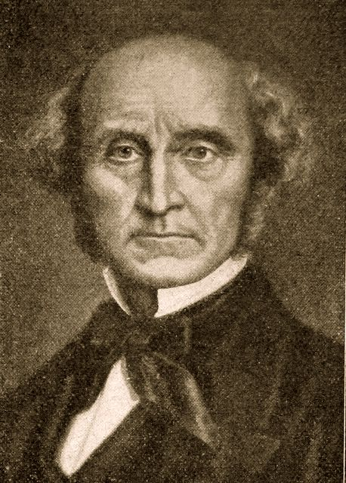
Utilitarianism
Variety of liberalism
“Greatest good for the greatest number”
Jeremy Bentham
John Stuart Mill
  Utilitarianism
  On Liberty
Critiqued by Dickens

Slide 4
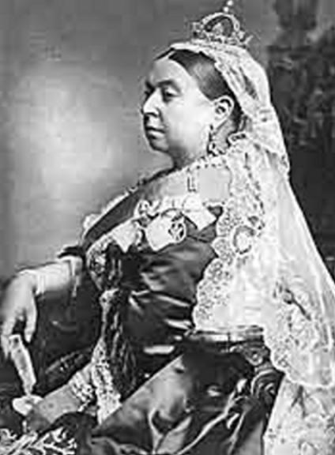
Britain
“Victorian Age”
No revolutions
Conservatives and liberals
  Benjamin Disraeli and the Reform Bill of 1867
  William Gladstone and the “Great Ministry”

Slide 5
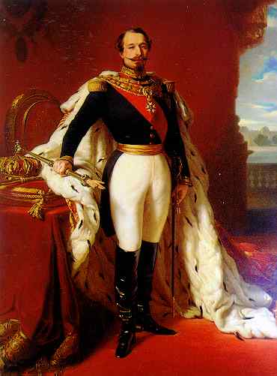
France
Louis Napoleon ➔ Napoleon III (1852)
Industrialization
Foreign adventures
  Crimea, Italy, Mexico
  Suez Canal
Deposed in Franco-Prussian War

Slide 6
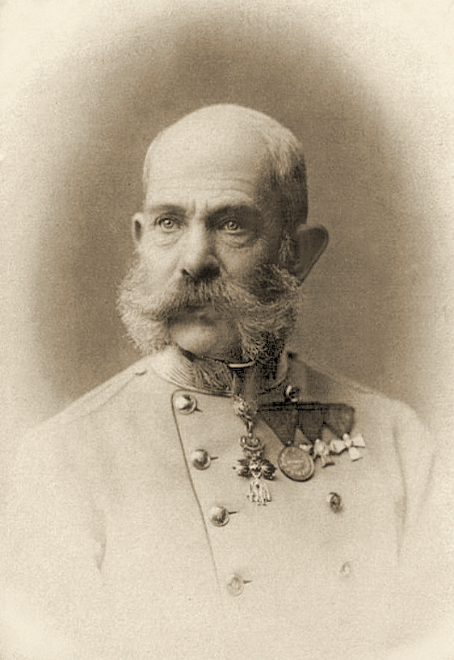
Habsburg Empire
Emperor Franz Josef I
Losses in Italy
Failure of the Grossdeutsch position
Ausgleich (1867)
Constitutionalism

Slide 7
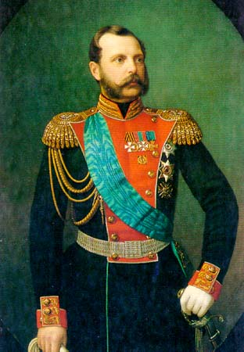
Russia
Tsars alternately progressive and reactionary
Alexander II (1855-1881)
Abolition of serfdom (1861)
Anarchist terrorism

