Slide 1
Western Civilization Since 1500
Lecture 26: Italian and German Unification

Slide 2
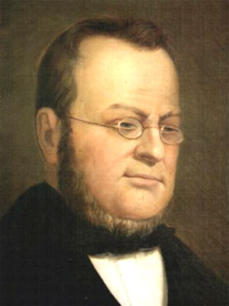
Italian Unification
Key state: Kingdom of Piedmont-Sardinia
Camillo Benso di Cavour
Help from France
Unites north in 1860
Garibaldi in the south
Venice and Rome

Slide 3
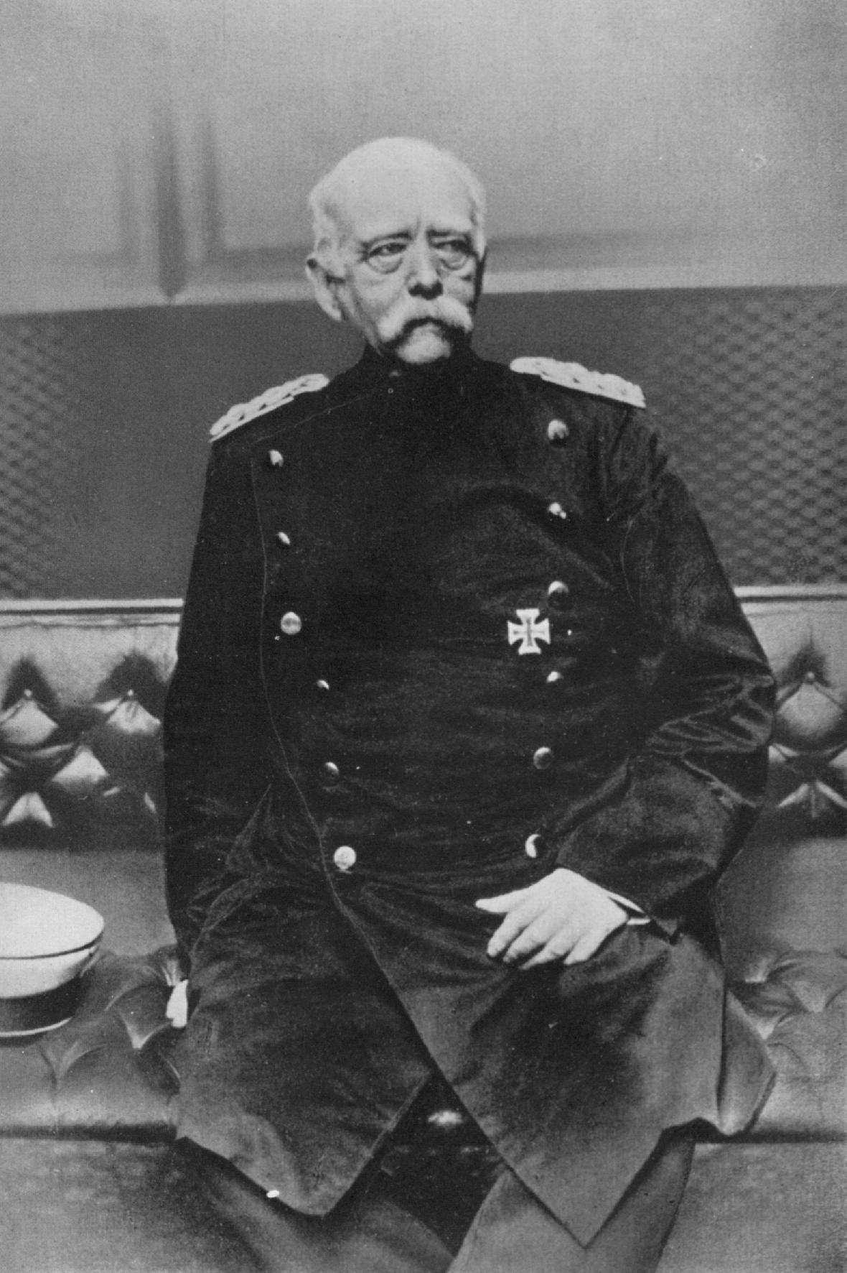
German Unification
Prussian plan
Erfurt Union and “Humiliation of Olmütz”
Crimean War (1853-1855)
Otto von Bismarck
Realpolitik

Slide 4
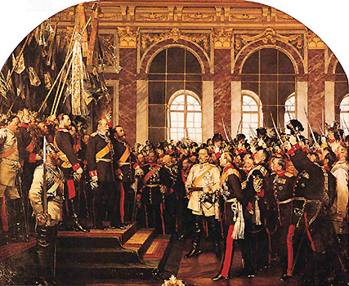
German Unification (2)
Wars of Unification
  Schleswig-Holstein (1864)
  Seven Weeks War (1866)
  Franco-Prussian War (1870)
Second Reich declared at Versailles
Kaiser William I

