Slide 1
Western Civilization Since 1500
Lecture 24: Revolutions of 1848

Slide 2
Background to Revolution
Pressure on conservative governments
  Liberalism
  Socialism
  Nationalism
  Democracy
Food crisis

Slide 3
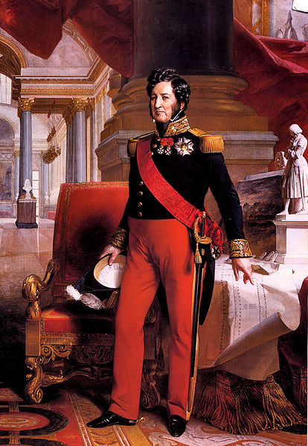
France: The First Domino
Dissatisfaction with Louis Philippe
  Assassination attempts
  “Reform Banquets”
Second Republic
  Louis Blanc and “National Workshops”
  Parliamentary elections

Slide 4
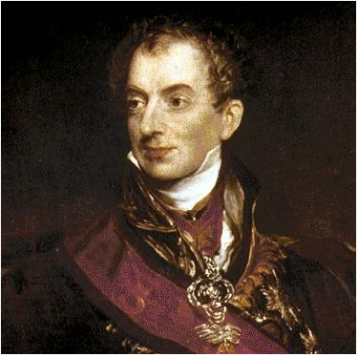
Austria
Following French lead
Metternich fired
Emperor abdicates
Nationalities demand autonomy
  Milan & Venice
  Slavs
  Magyars

Slide 5
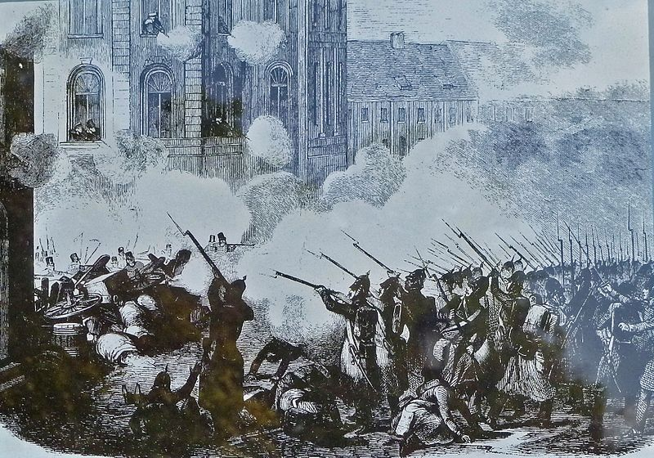
German States
Influence of nationalism
Call for constitutions, elections, civil liberties
Frankfurt Parliament
  Liberal acadmics
  Wanted constitution for German unity

Slide 6
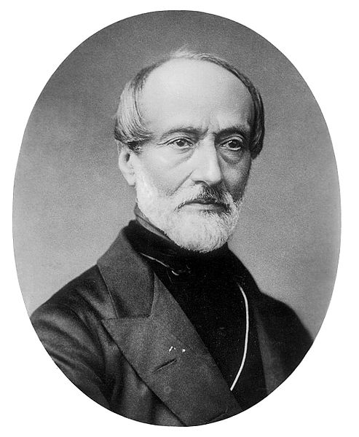
Italian States
Anti-Austrian actions
Pope Pius IX (1846-1878)
Giuseppe Mazzini and Giuseppe Garibaldi
Republic declared 2/1849

Slide 7
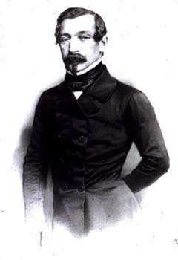
Failure in France
Elections return conservatives, moderates
June Days
12/1848 – Louis-Napoleon Bonaparte becomes president
12/2/1851 – coup makes L-N emperor (Napoleon III)

Slide 8
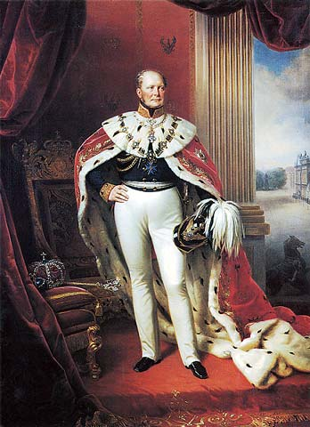
Failure Elsewhere
Austria: Russia helps defeat rebels
German States: Frederick IV refuses crown from Frankfurt Parliament
Italy: France restores Pius IX to power

Slide 9
Impact of Revolutions
Some lasting changes
  Serfdom ends in Austria, Prussia
  Democratic process in France
Bad blood between middle and lower classes
Failure of liberal nationalism

