Slide 1
Western Civilization Since 1500
Lecture 23: Neoclassicism and Romanticism

Slide 2
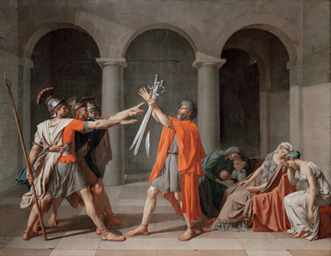
Neoclassicism
Classical and Enlightenment influences
Balance, symmetry
Architecture
Jacques-Louis David: Oath of the Horatii

Slide 3
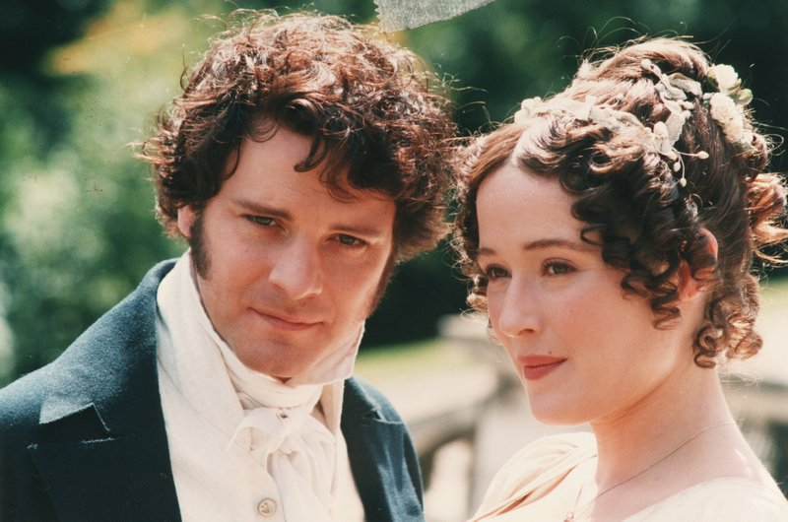
Neoclassicism in Literature
Augustan Age
  Alexander Pope
  Novels
Samuel Johnson
  Dictionary
  Boswell’s Life
Jane Austen
  Pride and Prejudice
  Emma

Slide 4
Romanticism
Reaction to Enlightenment rationalism and Industrial Revolution
  Emotion and subjectivity
  Destruction of artistic forms
  Revival of religion
  Veneration of the remote past
  Veneration of nature
Not tied to any specific political view

Slide 5
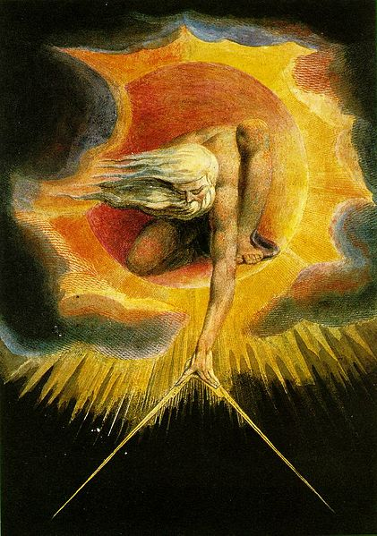
Romantic Poetry
Wordsworth and Coleridge: Lyrical Ballads (1798)
William Blake
Byron, Shelley, Keats
Goethe: Faust

Slide 6

Romantic Novels
Goethe—Sorrows of Young Werther (1774)
Mary Shelley—Frankenstein
Sir Walter Scott
  Ivanhoe
  Rob Roy

Slide 7
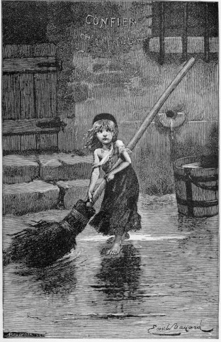
Romantic Novels
Charlotte Brontë – Jane Eyre
Emily Brontë – Wuthering Heights
Victor Hugo – Les Miserables
Americans: Irving, Cooper

