Slide 1
Western Civilization Since 1500
Lecture 21: Reaction and Conservatism, 1815-1830

Slide 2
Congress of Vienna (1814-1815)
Austria: Klemens von Metternich
Great Britain: Lord Castlereagh
Russia: Tsar Alexander I
Prussia: Frederick William III
France: Charles-Maurice de Talleyrand-Perigord; Louis Bourbon (XVIII)

Slide 3
Principles of Settlement
Compensation for victors
Legitimacy
Balance of Power
  Belgium and Netherlands united
  Germany as a “buffer zone”
  Italy consolidated

Slide 4
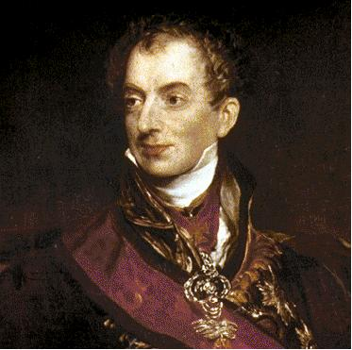
Conservatism
Pro-tradition, anti-revolutionary
Champions of monarchy, aristocracy, church
Dominant in government to 1830
Edmund Burke
Klemens von Metternich

Slide 5
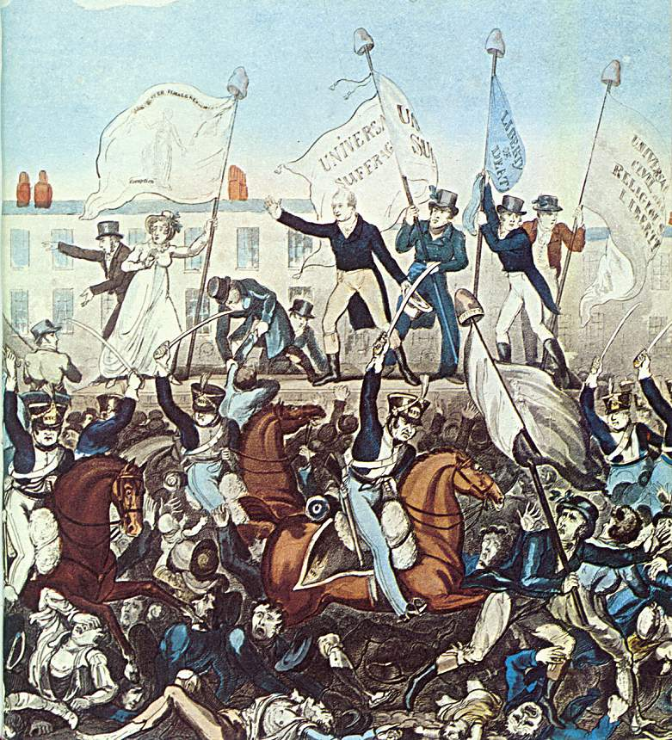
Conservatism (2)
Quadruple Alliance
Holy Alliance
Concert of Europe
  Italy
  Spain
  Troppau Protocol
Burschenschaften and Carlsbad Decrees
“Peterloo”

