Slide 1
Western Civilization Since 1500
Lecture 20: Industrial Revolution on the Continent

Slide 2
Demographic Changes
Imitation of English and Dutch agricultural advances
Increased crop yields and infrastructure improvements
Population more than doubled, 1800-1900

Slide 3
Industrialization Trends
Process very uneven among regions
Different amounts of State intervention
Varying cultural attitudes toward commerce and industry

Slide 4
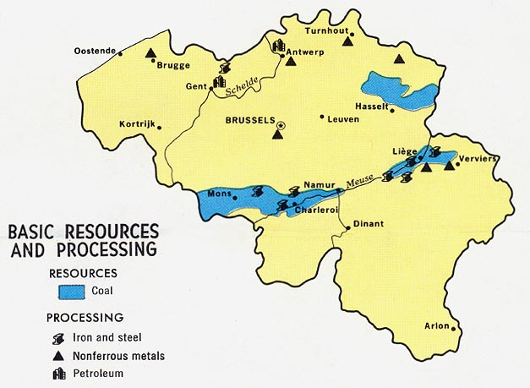
Belgium
1st continental state to industrialize
Similarities to Britain
  Geographical proximity
  Coal deposits
Competing with Britain by 1850

Slide 5
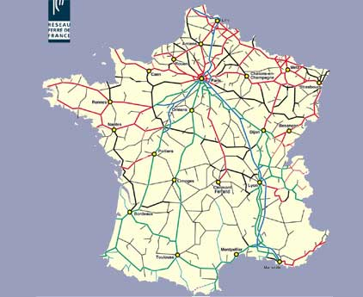
France
Slow and steady industrialization
Low population growth
Stable rural population
Top-down direction
Stability at expense of progress

Slide 6
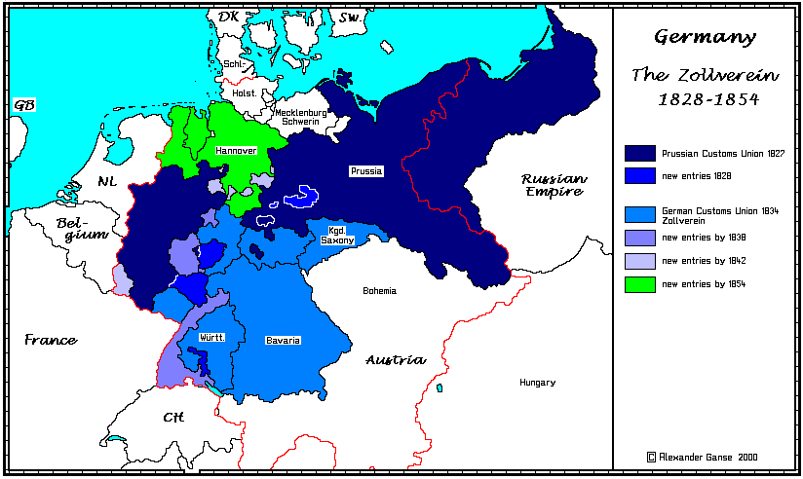
North German States
Politicized process
Many trade barriers, some serfdom in 1800
Zollverein (1834)
Railroads
Stiff competition for British by 1900

Slide 7
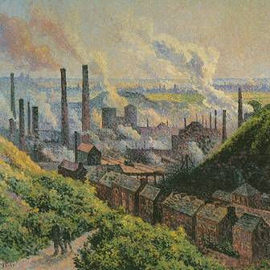
Southern/Eastern Europe
Very slow & spotty industrialization
Geography
Fewer resources
Social hindrances
Symbols without substance

Slide 8
Social Impact
Urbanization
Concentrations of poverty
  Prostitution
  Crime and police forces
  Increased debate over State’s role in economy and society
Reexamination of gender roles

