Slide 1
Western Civilization Since 1500
Lecture 19: Industrial Revolution in Britain

Slide 2
Review: Agricultural Revolution
New farming techniques increase agricultural yields in Britain and Low Countries
Enclosure pressures peasants to move
More involvement in manufacturing through the “putting-out” system

Slide 3
What is the Industrial Revolution?
Mass production for mass consumption
Production shifts: labor-intensive➔capital-intensive
  Productivity increases dramatically
  New sources of power
  Power machinery

Slide 4
Why Britain?
Decent natural resources (coal, tin) and waterways
Less prejudice against commerce
Flexibility of society and economy
  Inventors profit by responding to consumer desires
  No central plan (although some infrastructure spending by government)

Slide 5
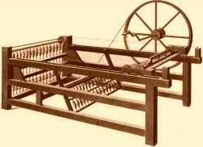
Textiles Lead the Way
Increasing population ➔ higher demand
Wool ➔ cotton
  India
  United States
Inventions
  John Kay—flying shuttle
  James Hargreaves—spinning jenny

Slide 6
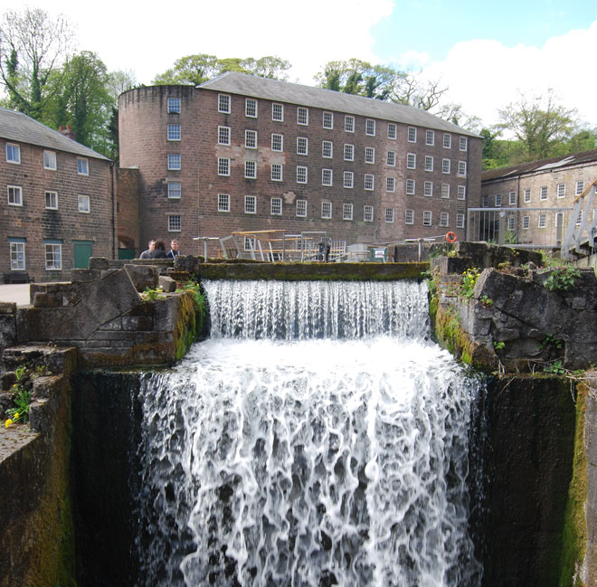
Textiles (2)
More inventions
  Richard Arkwright—water frame
  Samuel Crompton—water mule
  Edmund Cartwright—power loom
Factory system
  Workers ➔ machines
  Population movements

Slide 7
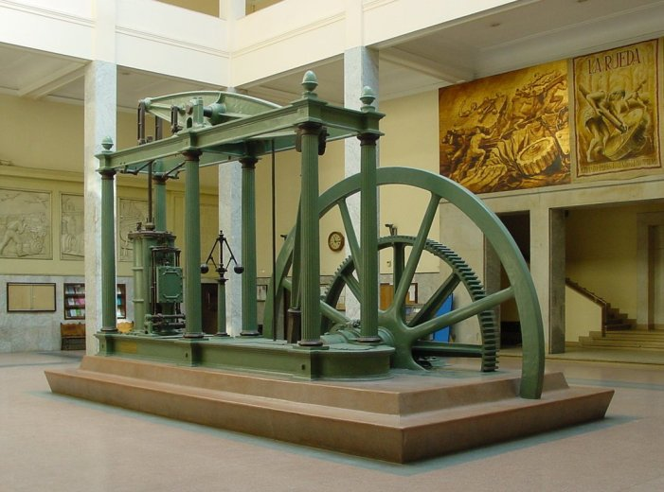
New Power Sources
Coal
  Easy deposits tapped quickly; deep mining needed
  Thomas Newcomen—steam engine
James Watt—condensing steam engine

Slide 8
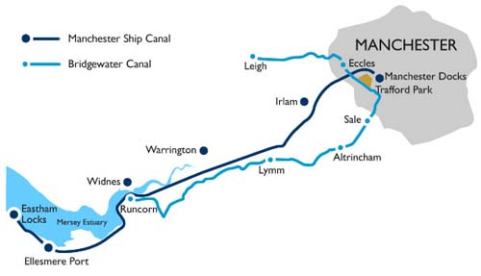
Transportation Improvements
Transportation follows production
  Raw materials ➔ factories
  Finished goods ➔ markets
  Workers ➔ factories
Canals
Railroads

Slide 9
Changes
Urbanization
Population growth
Unprecedented capital accumulation
Rising standards of living
  Working conditions
  Diet, housing, etc.

