Slide 1
Western Civilization Since 1500
Lecture 18: Napoleon

Slide 2
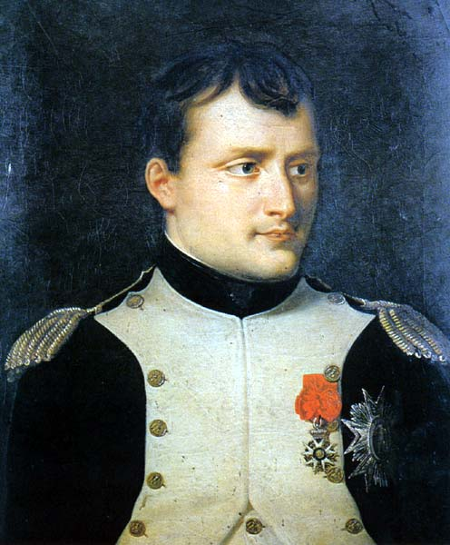
Republic➔Empire
Napoleon Bonaparte (1769-1821)
1799 – overthrow of the Directory; “First Consul”
1802 – consul for life
1804 – Napoleon crowns himself emperor

Slide 3
Napoleon’s Domestic Policy
Concordat with Rome
Code Napoleon
  Standardization
  Enlightenment influence
Centralized administration
New aristocracy

Slide 4
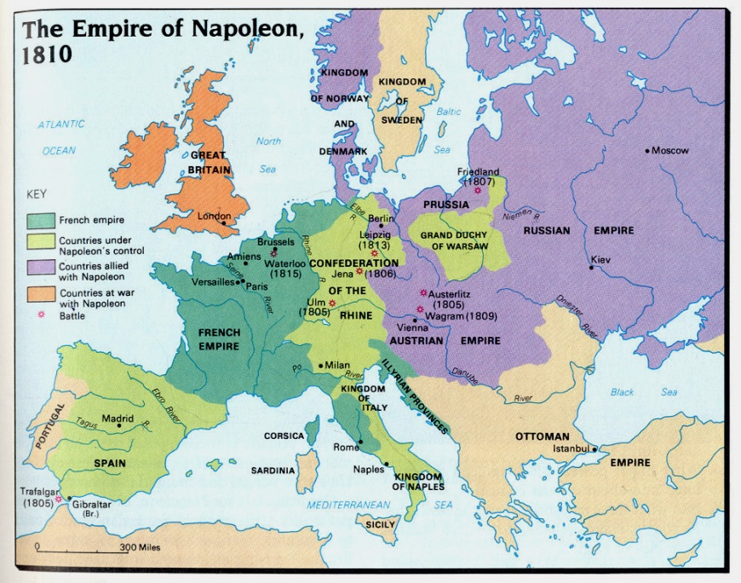
France at War
Constant war, 1792-1815
Napoleon’s battles
  Austerlitz (1805)
  Trafalgar (1805)
Impact
  Code Napoleon
  Restructuring of Germany
  Nationalism

Slide 5
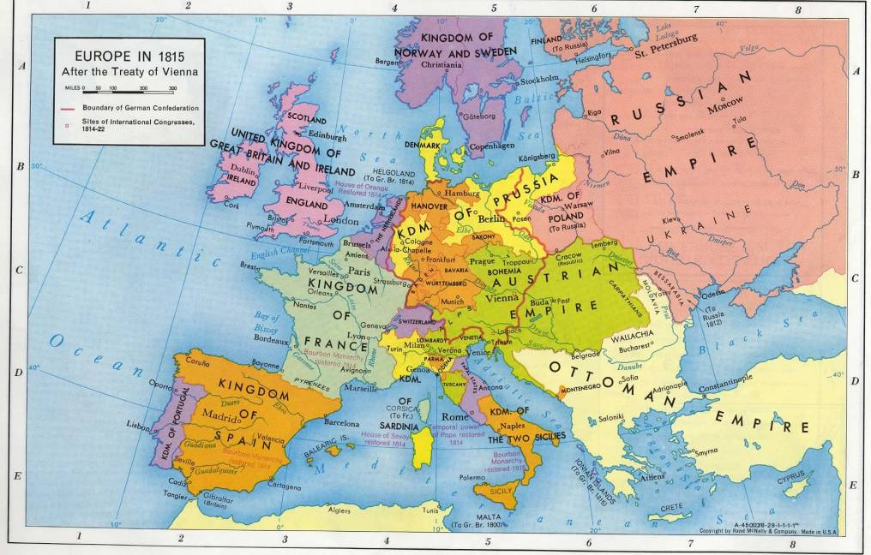
Napoleon Defeated
1812 – Invasion of Russia
1814 – defeat and exile to Elba
1815
  “Hundred Days”
  Battle of Waterloo
  Exile to St. Helena
Congress of Vienna (1814-1815)

