Slide 1
Western Civilization Since 1500
Lecture 17: French Revolution

Slide 2
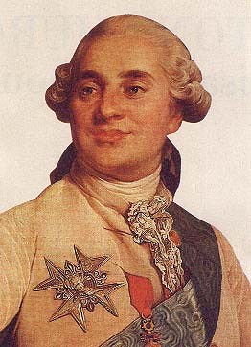
Background
Spread of Enlightenment ideas
  Salon culture
  Gutter journalism
  Secret societies
Louis XVI (1774-1792)
French debt

Slide 3
The Revolution Begins
1789—Estates-General
Economic hardship
  Unemployment
  High prices
Storming the Bastille (14 July 1789)

Slide 4
“Moderate” Phase
“Declaration of the Rights of Man and Citizen”
Assembly abolishes aristocratic privileges
1790 – Civil Constitution of the Clergy
Constitution of 1791
  Property rights protected
  Mob calls for democracy

Slide 5
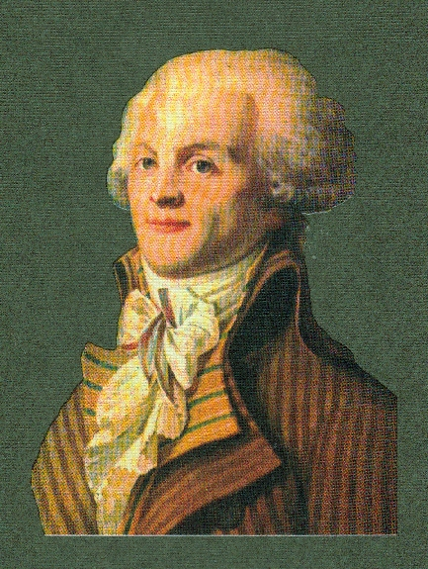
Radicals In Charge
War declared on Austria
1792 – Louis and family flee
Abolition of monarchy
Execution of Louis XVI (1793)
Reign of Terror (1793-1794)
  Jacobins
  Maximilien Robespierre
  Guillotine
  Vendee

Slide 6
Radicals In Charge
Christophobia
  “Cult of the Supreme Being”
  Changes to calendar
Edmund Burke – Reflections on the Revolution in France (1790)
Thermidorean Reaction (1794)

Slide 7
The Directory (1794-1799)
Reaction against Terror
Middle-of-the-road
  Churches reopened
  Economic regulations relaxed
Foreign wars continued
Pervasive corruption and graft

