Slide 1
Western Civilization Since 1500
Lecture 16: 18th-Century Economy and Society

Slide 2
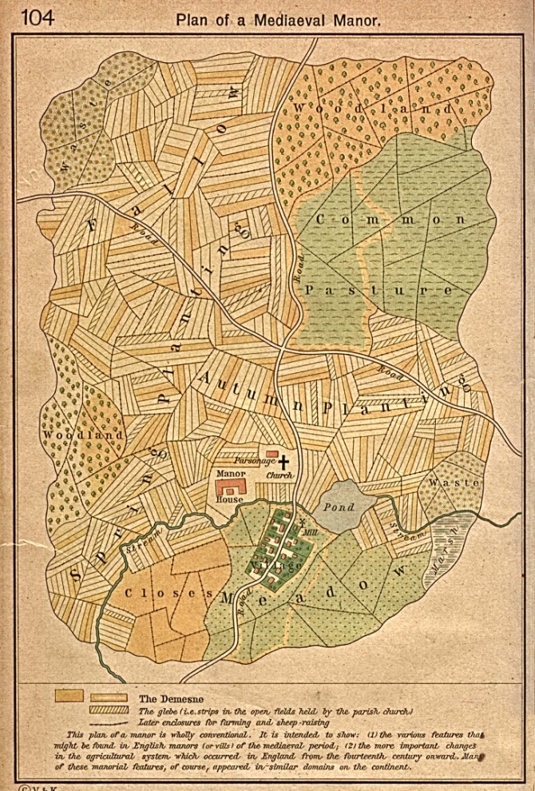
Traditional Economy
Manorialism
Features of manor
Mutual obligations
Farming methods
  2-field and 3-field systems
  Low yields

Slide 3
Agricultural “Revolution”
Landlords’ problem: fixed rents in a period of inflation
Solution: open-field system ➔ enclosure
  Common lands fenced off by landowners
  Landless often, in effect, forced off land
  Improved incentives and efficiency

Slide 4
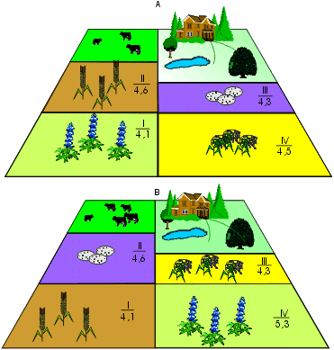
“High Farming” (1)
No more fallow fields
Crop rotation
  Nitrate-replenishers
    Turnips, clover, etc.
    Doubled as fodder
Convertible husbandry

Slide 5
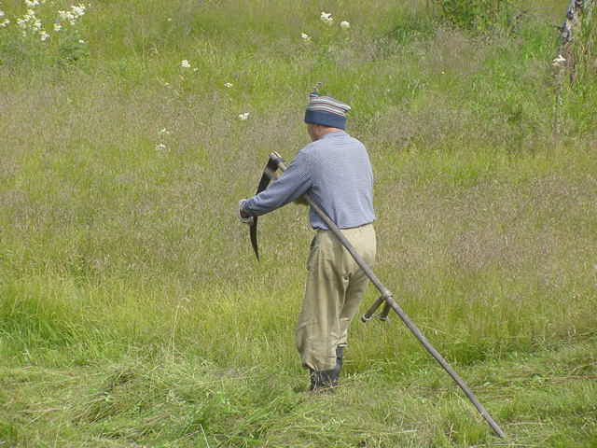
“High Farming” (2)
Seed-drilling replaced broad-cast seeding
Advances in plowing
  All-metal plows
  Change from oxen to horses
Change from sickle to scythe

Slide 6
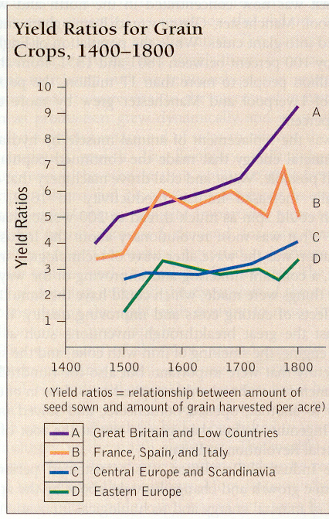

Slide 7
Cottage Industry
Enclosure and high farming “freed” many agricultural laborers to work in manufacturing
“Putting-out” system
  Merchant buys raw materials (e.g. wool) in bulk
  He deployed them to villages for processing (e.g. spinning, weaving)
  He paid villagers a wage, collected the finished product, and re-sold it for a profit in another market

