Slide 1
Western Civilization Since 1500
Lecture 15: 18th-Century Politics and War

Slide 2
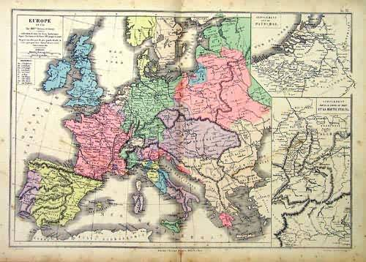
Political Landscape—1700
Great Powers
  France (Bourbon)
  England➔Britain (Hanover)
  Austria (Habsburg)
Rising Powers
  Prussia (Hohenzollern)
  Russia (Romanov)
Declining Powers
  Spain
  Netherlands

Slide 3
The Ancien Regime
Spread of Absolutism in 18th c.
  Centralization of Power
  Increased taxation
  Standing armies
“Enlightened Despotism”
  Austria (Maria Theresa, Joseph II)
  Prussia (Frederick II “the Great”)
  Russia (Catherine “the Great”)

Slide 4
18th-Century Warfare
Dynastic Wars
  Spanish Succession (1702-1714)
  Polish Succession (1733-1738)
  Austrian Succession (1740-1748)
Seven Years War (1756-1763)
  Britain/Prussia vs. Austria/France/Russia
  Prussia survives with territory intact
  Britain conquers French colonies (India, North America)

