Slide 1
Western Civilization Since 1500
Lecture 14: Enlightenment (2)

Slide 2
Economics—A New Science
Background of mercantilism
“Political Economy”—relation of study to State policy
French economists: “physiocrats”
  Drew on thought of late Scholastic philosophers
  Argued against anti-farm policies of French government
  Wanted more a of a free market

Slide 3
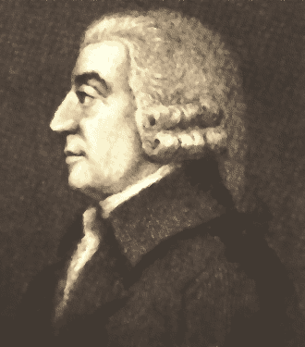
Adam Smith (1723-1790)
Part of Scottish Enlightenment
Wealth of Nations (1776)
Division of labor
Private vice is public gain?
“Invisible hand” of the marketplace

Slide 4
A New Philosophy of History
Skepticism toward ancient sources
  Don’t trust the narrative
  Seek for internal “clues” to learn more about authors and their times
Giambattista Vico (1668-1744) and Philosophy of History
Edward Gibbon (1737-1794) and The Decline and Fall of the Roman Empire

Slide 5

Jonathan Swift (1667-1745)
Irish clergyman
Pessimist, challenged Enlightenment confidence
Bitter satires
“A Modest Proposal” (1729)
Gulliver’s Travels (1726)
  In four parts
  Narrator becomes a misanthrope

Slide 6

Philosophes
Denis Diderot (1713-1784) and the Encyclopedie
  28 volumes
  Summary of Enlightenment thought
Montesquieu and Spirit of the Laws

Slide 7
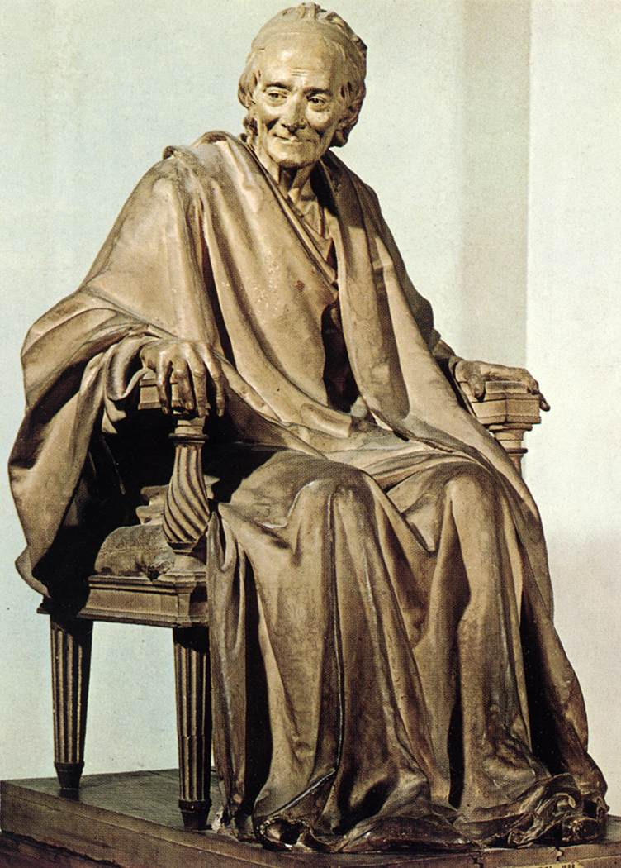
Voltaire (1694-1778)
Most famous philosophe
Diehard skeptic, enemy of Christianity
Praised English constitutionalism
Satire: Candide (1759)

