Slide 1
Western Civilization Since 1500
Lecture 13: The Enlightenment (1)

Slide 2
“What Is Enlightenment?”
Erosion of traditional authority
  Revelation (Bible)
  Classical texts
  Aristocracy
New authority is human reason
  Philosophes—anti-nobility, anti-church
  Religion (deism)
  Political theory (social contract)

Slide 3
Empiricism
John Locke (1632-1704)
  Essay Concerning Human Understanding
  Human mind is a tabula rasa at birth
David Hume (1711-1776)
  An Enquiry Concerning Human Understanding
  Human mind unable to discern causality
  Influential argument against miracles

Slide 4
Enlightenment Political Theories
“Rational” theories of the State
  Absolutism—State controls everything
  Constitutionalism—State power is strictly limited

Slide 5
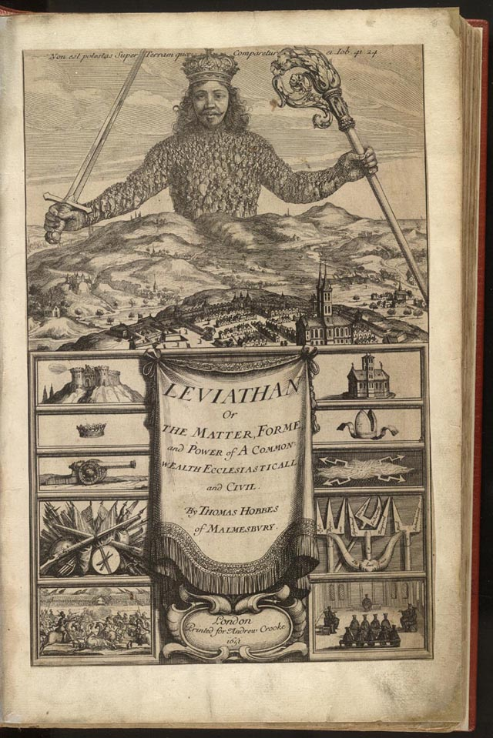
Thomas Hobbes (1588-1679)
Most controversial philosopher of mid-17th century
Leviathan (1651)
Imaginary “state of nature”
The “social contract” creates the State, a “mortall God”

Slide 6

Jean-Jacques Rousseau (1712-1788)
France➔Switzerland
The Social Contract (1762)
The “noble savage”
Society corrupts Man
The State must have power in order to help perfect Man

Slide 7
Hobbes vs. Rousseau
Differences
  Views of human nature
  Outlooks for humanity
Similarities
  Abandonment of Biblical presuppositions for “rational” speculation
  Absolutism
  Negligence of “mediating institutions” (family, church, guilds, etc.)

Slide 8
Constitutionalism and Locke
Two Treatises on Civil Government
State of nature
Distinctive notion of property and rights
Right of resistance if ruler breaks the social contract

