Slide 1
Western Civilization Since 1500
Lecture 12: Scientific Revolution

Slide 2
The Modernist Fairy-Tale
Middle Ages contributed nothing to science
  Superstition reigned
  People were stupid
As society became more secular and rational, scientific knowledge increased
There is an inherent conflict between science and Christianity

Slide 3
In Reality . . .
The Middle Ages did have scientific advances
Through the 19th century, almost all scientists were professing Christians
Christianity provided an incubator for science
  Theology of dominion (nature good, not a god)
  Orderly God, orderly universe
  God’s creation ex nihilo means precision

Slide 4
Impetus for the Revolution
Question: If secularization wasn’t the driving force, what was?
Answer: the conflict between different ancient philosophies, all interpreted “Christianly”
  Aristotelianism
  Platonism
  Mechanism

Slide 5
Methodologies: Induction
Francis Bacon(1561-1626)
  Novum Organum: warnings of “Idols”
  Empiricist: emphasis on experimentation
English examples
  William Gilbert: On the Loadstone and Magnetic Bodies (1600)
  William Harvey: Anatomical Disquisition on the Circulation of the Heart and Blood (1628)

Slide 6
Methodologies: Deduction
Rene Descartes (1596-1650)
  Discourse on Method and deductive reasoning
  Doubt everything, but cogito ergo sum
  Proof of God
  God’s existence implies the world’s existence

Slide 7
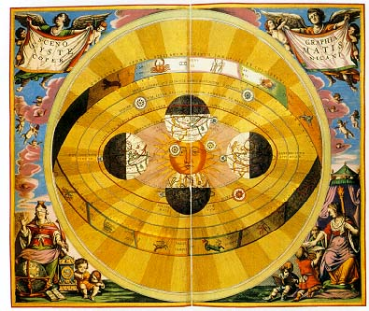
Nicolas Copernicus (1473-1543)
Platonist dissatisfied with Aristotelian geocentric theory
Proposed heliocentric model in On the Revolutions of the Heavenly Spheres
A mathematically simpler model
Successors elaborated

Slide 8
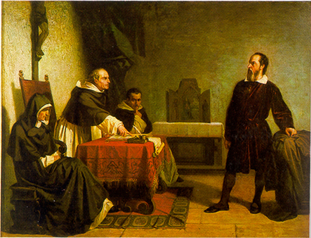
Galileo Galilei (1564-1642)
Mechanist
Mathematical laws govern all physical bodies (incl. planets)
Heresy trial: a martyr for science? (G.G. made dogmatic, unsubstantiated claims too)

Slide 9
Copernican Impact
Popular secular theory: Copernicus weakened Christianity
  If earth is the center, humans are special
  If not, we’re not important; where is God?
  So the geocentric theory is a moral crutch
But did Copernicus provide the crutch?
  To medieval mind the center is the worst place
  Drifting Earth and no God means no accountability; humans can make their own rules

Slide 10
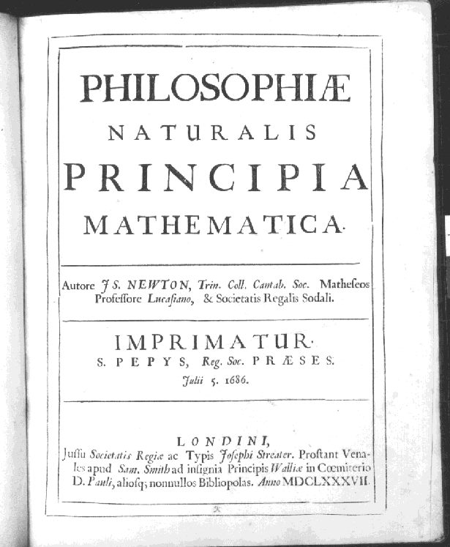
Isaac Newton (1642-1727)
Synthesis
  Kepler and Galileo
  Platonism and mechanism
Discovered calculus
Theory of Gravity
Optics
Three Laws of Motion (inertia, acceleration, action-reaction)

Slide 11
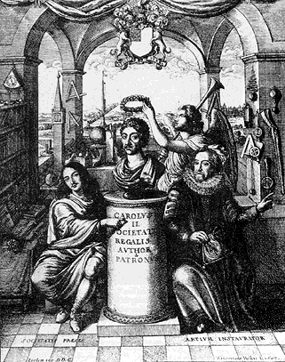
Science and Society
Elites embraced science
  New institutes, academies
  Royal Society ➔
Universe increasingly seen as a machine instead of an organism
Groundwork for new technology, Ind. Rev.

