Slide 1
Western Civilization since 1500
Lecture 11: Constitutionalism

Slide 2
Constitutionalism
Philosophy that the power of kings was limited
“Sovereignty” located elsewhere, usually “the people”
Importance of Calvinism

Slide 3
Vindiciae Contra Tyrannos
Context: French Wars of Religion (1570s)
Can one resist the king? When and how?
  2 classes of people: officers, private persons
  Private persons may not initiate resistance
  “Lesser magistrates” have the duty to defend the church against a tyrant
  Individuals may assist resisting magistrates
Notes:
This slide accompanies the selection “A Calvinist Attacks Absolutism” from the reader.

Slide 4
Other Constitutionalist Theorists
John Knox (1514-1572)
  Leader of Protestant Reformation in Scotland
  Sovereignty in “the people”; monarch is the people’s agent
Juan de Mariana (1536-1624)
  Jesuit open to a tyrant’s overthrow
John Locke (1632-1704)
  Two Treatises on Civil Government

Slide 5
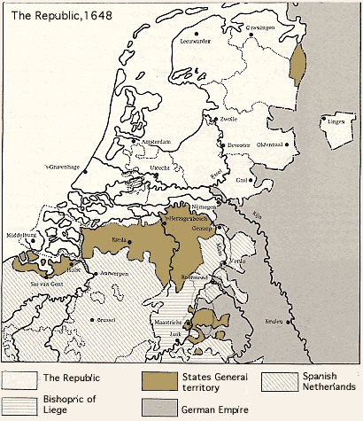
Dutch Revolt
1560s – resistance to Spanish crackdown on Protestants
1572 – open revolt (William of Orange)
Foreign intervention
1609 – Truce and de facto independence (made official in 1648)

Slide 6
Postwar Netherlands
Republican government with House of Orange in a leadership role
Commercial empire in Europe, North America, Africa, India, East Indies
Weakened by wars with England and France, but remained independent

Slide 7
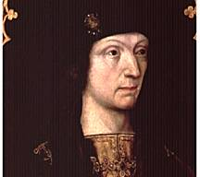
Tudor “Absolutism”
Wars of the Roses (1455-1485)
Henry VII (1485-1509)
  Centralizer
  Commoners in govt.
Sense of nationhood
  Rebellions ending
  Reformation
  Spanish Armada

Slide 8
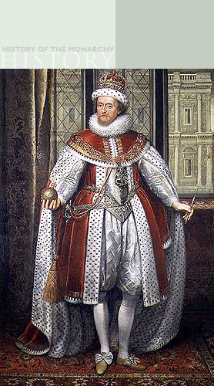
Stuart England
James I (1603-1625)
  Religion
  Parliament
Charles I (1625-1649)
  Petition of Right (1628)
  Personal Rule (1629-1640)
  Tensions over religion and taxes

Slide 9
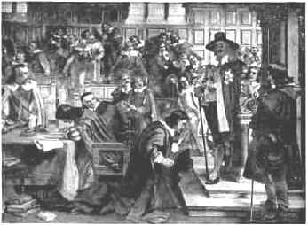
Crisis
Bishops Wars (1637)
Short Parliament (1640)
Long Parliament (1640-1660)
Executions of Charles’ ministers

Slide 10
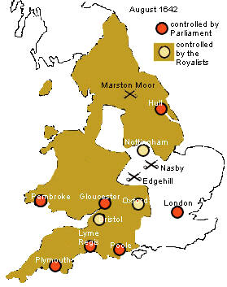
Civil War (1642-1649)
Cavaliers vs. Roundheads
Oliver Cromwell
Presbyterians and Independents
“Root and Branch” Petition; WCF (1644)
Independents execute Charles (1/1649)

Slide 11
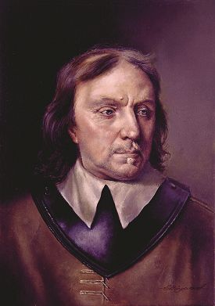
The Interregnum (1649-1660)
Commonwealth
  Monarchy, Lords abolished
  Wars (Scots, Irish, Dutch)
Protectorate
  Cromwell as Lord Protector
  1658 – Cromwell dies, son Richard succeeds

Slide 12
“The World Turned Upside Down”
Interregnum brought social upheaval
Religious sects
  Baptists
  Quakers
  Ranters
Political radicals
  Levellers (Putney Debates)
  Diggers

Slide 13
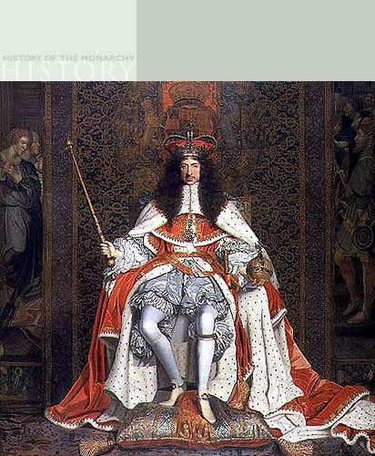
Restoration England
1660 – Gen. Monck seizes power, offers crown to Charles II (1660-1685)
Absolutism?
  Royal control of army
  Re-established Church
  Cavalier Parliament
  Clarendon Code

Slide 14
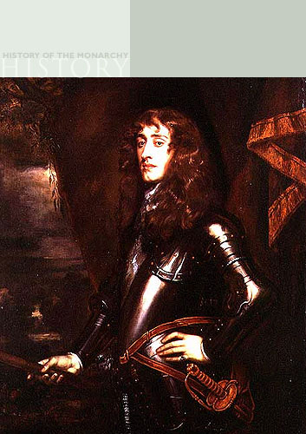
Restoration England
Crises (wars, etc.)
Exclusion Crisis (1679-1681)
  James, duke of York
  Whigs and Tories
James II (1685-1688) and the “Glorious Revolution”
William and Mary

