Slide 1
Western Civilization since 1500
Episode 10: Absolutism and Mercantilism

Slide 2
Early Modern Monarchy
Kings gain strength in 16th-17th centuries
  Get firmer control over the Church
  Reduce power of nobility
  Become symbols of “national” unity
Absolutism
  Philosophy that kings have “sovereignty”
  “Divine Right of Kings”
  Jean Bodin: Six Books of the Commonwealth
  Thomas Hobbes: Leviathan

Slide 3
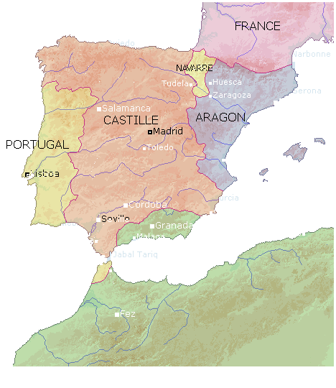
Spanish Centralization
1469 – Ferdinand of Aragon and Isabella of Castile marry
1492 – Reconquista completed; Jews and Muslims expelled
Bought off Castilian nobles

Slide 4
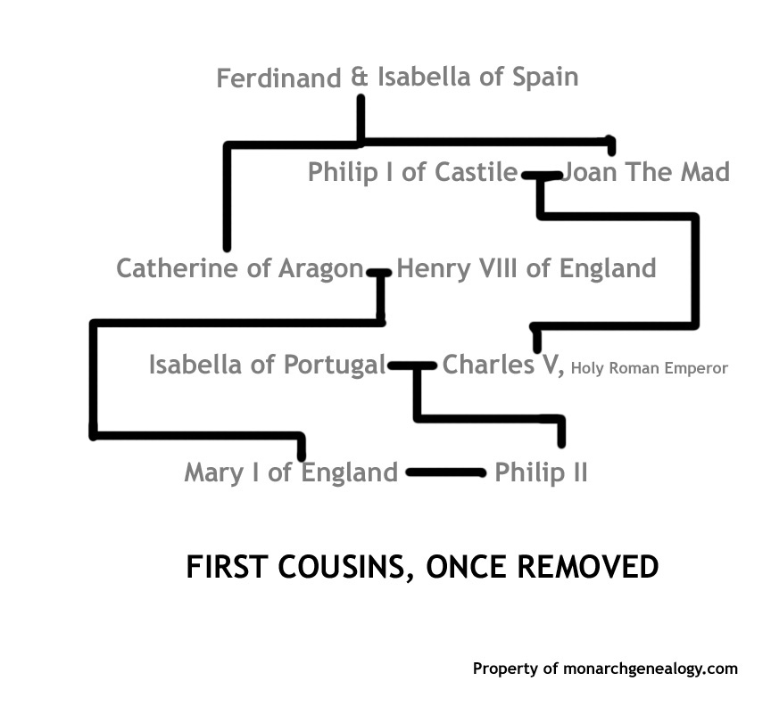
Habsburg Genealogy

Slide 5
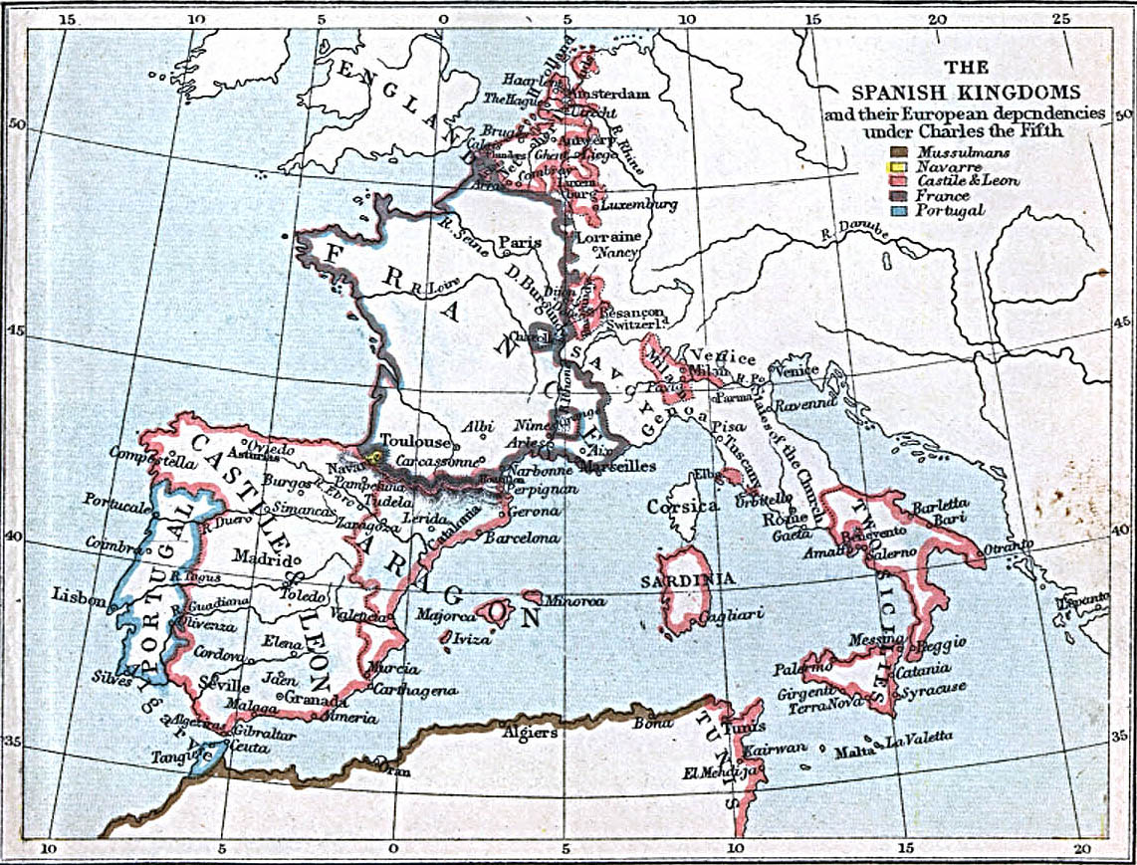
Habsburg Spain
Charles I/V (1516/1519-1555) vs. French, Turks, Protestants
Philip II (1556-1598)
  Built up Madrid, Escorial
Wars against Turks (1559-1577)
  Holy League (Spain, Venice, Papacy)
  Lepanto (1571)
Failures against Dutch, English

Slide 6
Economic Decline
Fiscal irresponsibility
  Huge military expenditures
  Multiple bankruptcies
  Policies discouraged commerce, development
New World treasure dried up
Increased taxation
Disillusionment – Cervantes and Don Quixote

Slide 7
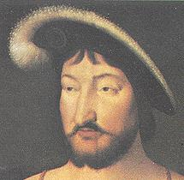
French Centralization
Valois Dynasty (1328-1589)
Francis I (1515-1547)
  Pushed for taxing authority in peacetime
  Concordat of Bologna (1516)
Barrier: Huguenots

Slide 8
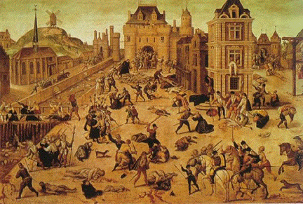
French Wars of Religion
Government factions
1562 – 3,000 Huguenots killed
St. Bartholomew’s Day Massacre (8/24/1572)
Henry IV (Bourbon) and Edict of Nantes (1598)

Slide 9
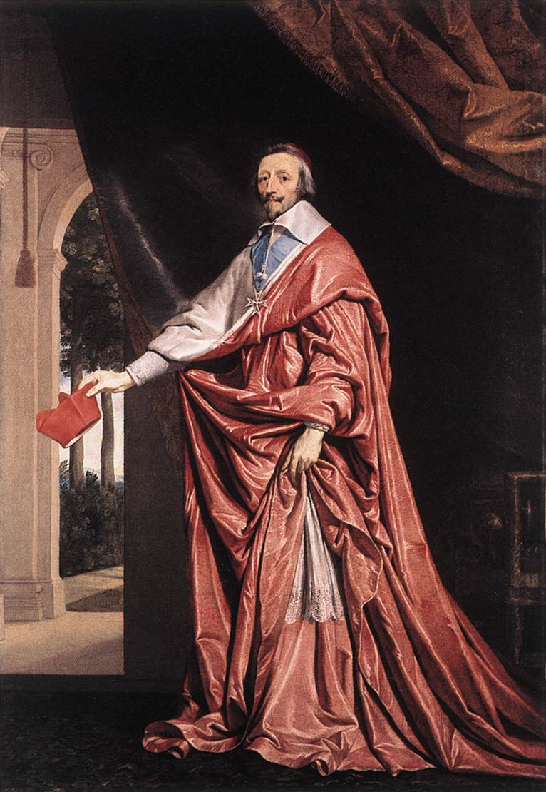
Bourbon Dynasty (1589-1793)
Louis XIII (1610-1643)
Cardinal Richelieu
Thirty Years War
  Prevented Habsburg dominance of Europe
  Alliance with Protestants (!)

Slide 10
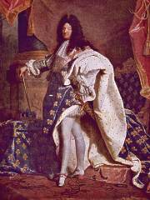
The Sun King
Louis XIV (1643-1715)
Regency and the Fronde
Destroyed local autonomy
L’etat, c’est moi
Persecution of Huguenots
War, war, war

Slide 11
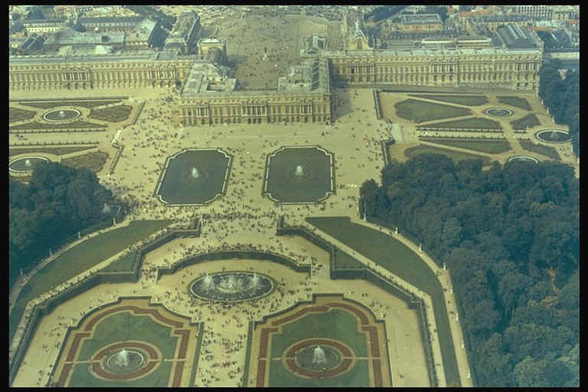
Versailles
Built 1669-1686
Co-opting of nobility
  Feasting
  Hunting
  Wenching
Center of European culture

Slide 12
Mercantilism
Jean-Baptiste Colbert
Foreign trade as a competition among states; State must control domestic economy to “win”
Bullionism
Import raw materials and currency, export manufactured goods

Slide 13
Mercantilism (2)
Tactics
  Tariffs on manufactured goods
  Subsidies to domestic manufacturers
  Attempts to control the carry trade
Wars of Commerce
  3 Anglo-Dutch wars (1652-1674)
  Wars of Louis XIV
  Dynastic wars of 18th century

