Slide 1
Western Civilization Since 1500
Lecture 9: English “Golden Age”

Slide 2
Elizabeth I (1558-1603)
Daughter of Henry VIII
“Virgin Queen”
Settled England as a Protestant kingdom
England becoming a world power
Inspired praise in music, art, and literature

Slide 3
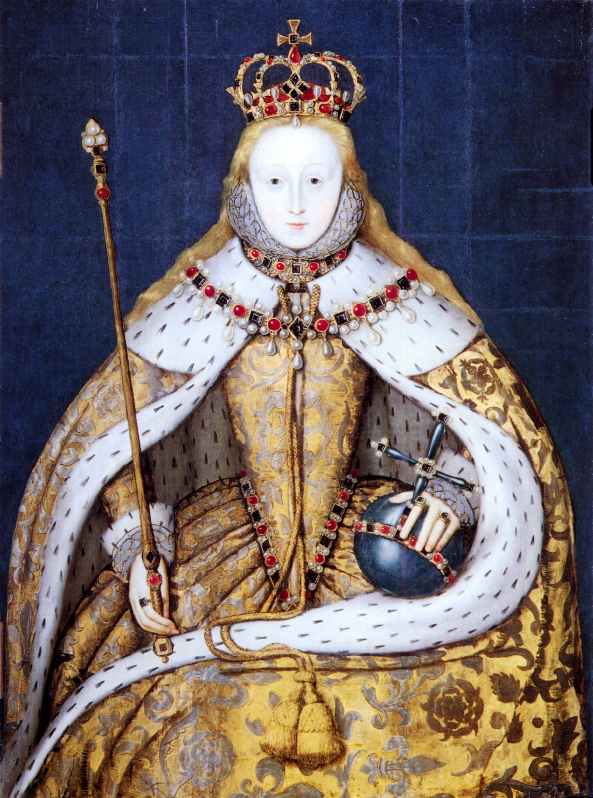

Elizabeth I

Slide 4
Edmund Spenser
Courtier and official in Ireland
The Faerie Queene (1590, 1596)
  Allegory of Christian virtues
    Holiness, temperance, chastity, friendship, justice, courtesy
    Embodied by knights (5 men, 1 woman)
  “Red Crosse” as St. George
  Laid foundation for most subsequent English literature

Slide 5
Early English Drama
Medieval mystery plays
  Sponsored by guilds
  Performed at churches
Tension between Church and drama
  Concern over obscenity
  Drama seen as lying
  Fear of rebellious ideas
Licensing of drama companies, theaters

Slide 6
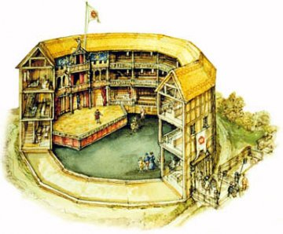
Globe Theater
Built 1599, burned 1613

Slide 7
Christopher Marlowe (1564-1593)
Controversial figure (politics, religion, sexuality)
Developed “blank verse”
Four plays (all tragedies) that changed drama and English literature
  Tamburlaine
  The Jew of Malta
  Doctor Faustus
  Edward II

Slide 8
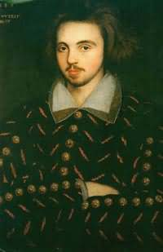
Christopher Marlowe

Slide 9
William Shakespeare (1564-1616)
Born in Stratford-on-Avon
Uncertainty about early career
Began writing plays in London in early 1590s (question of authorship)
Genres of plays
  Histories
  Comedies
  Tragedies

Slide 10
English Drama After Shakespeare
Jacobean drama
  Ben Jonson—comedies
  John Webster—tragedies
Censorship in mid-17th century
Restoration revival

Slide 11
King James Bible
King James I (1603-1625)
Hampton Court Conference
Team of 50 scholars
Influence of William Tyndale (1494-1536)
  Translated in 1520
  Executed for treason
Bedrock of the Church of England
Saturated the English mind

Slide 12
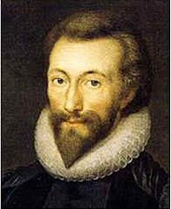
Metaphysical Poets
17th-century intellectuals
Key ideas: “wit” and “conceit”
John Donne (1572-1631)
Andrew Marvell (1621-1678)
Naughtiness
  “The Flea”
  “To His Coy Mistress”
Holiness: “Death, Be Not Proud”

Slide 13
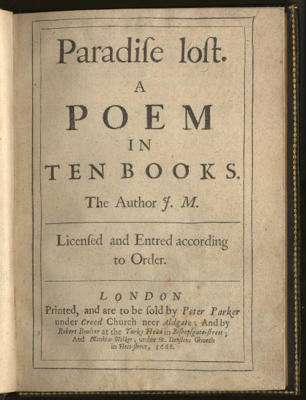
John Milton (1608-1674)
Puritan republican
Defended individual freedoms
Paradise Lost (1667)
  Epic poem
  Genesis—Fall of Man
  New poetic language
  Tension resulting from the felix culpa idea

