Slide 1
Western Civilization Since 1500
Lecture 8: Voyages of Discovery

Slide 2
Motives for Exploration
God
  Evangelism a primary concern for Church
  Catholic/Protestant rivalry (Jesuits)
Gold
  Search for new trade routes with Asia
Glory
  Outlet for military exploits of nobility (Spain)

Slide 3
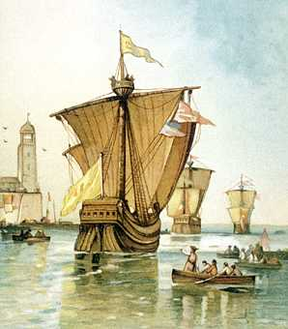
Secrets of European Success
Exploitation of internal divisions in indigenous societies
Superior technology: sailing ship, guns
Inadvertent transmission of disease

Slide 4
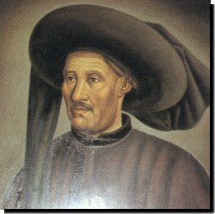
Portuguese Exploration
Prince Henry the Navigator (1394-1460)
Crusader ethos
Cutting out commercial middlemen
Expansion
  Atlantic islands
  African coast

Slide 5
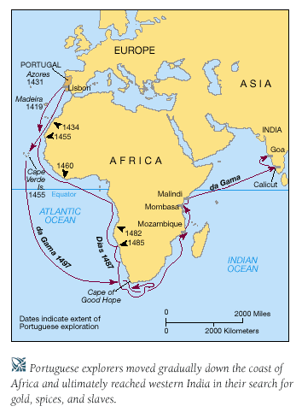
Portuguese Exploration
Bartholomeu Dias – Cape of Good Hope (1488)
Vasco da Gama – reached India (1498)
East Indies, Macao
Battle of Diu (1509)

Slide 6
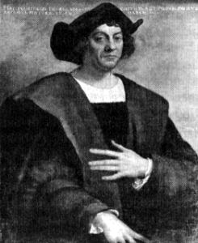
Spanish Exploration
Christopher Columbus and the flat-earth myth
Genoese employed by Isabella of Castile
Miscalculation of earth’s circumference

Slide 7
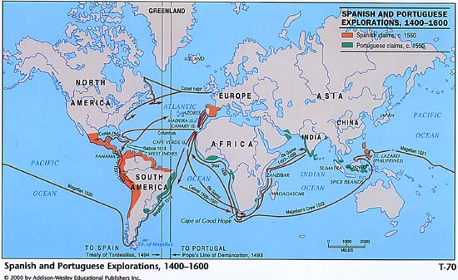
Spanish Exploration
Columbus—4 voyages
Vasco Nunez de Balboa—discovery of Pacific Ocean (1513)
Ferdinand Magellan—circumnavigation of the globe (1520-21)

Slide 8
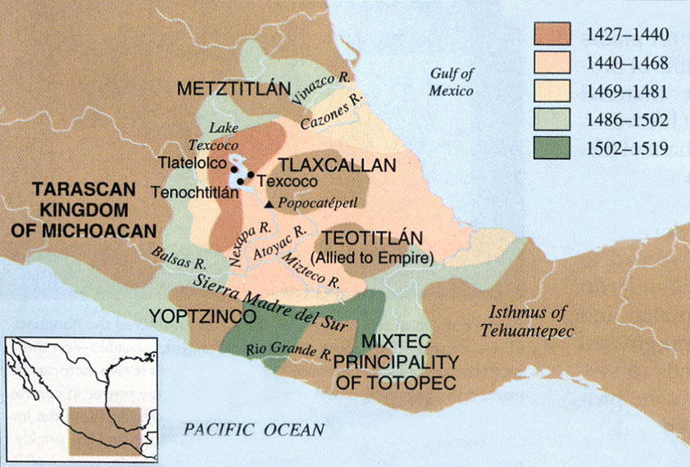
Conquest of Indian Empires
Aztec Empire
  14th-15th centuries
  Moctezuma II
Hernando Cortes and 500 Spaniards (1519)
Alliances with tributaries
A conqueror for Christ?

Slide 9
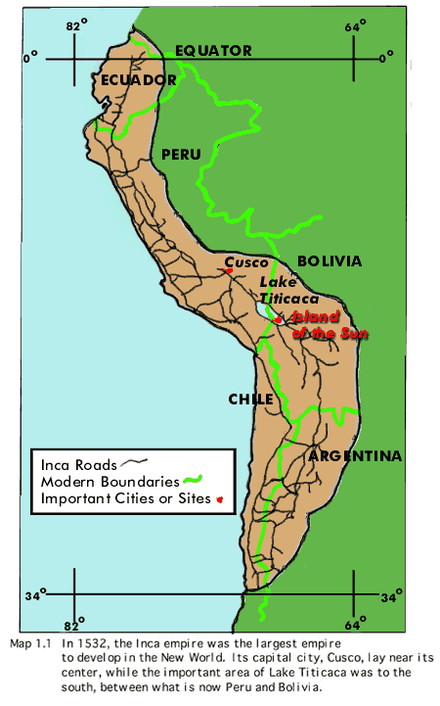
Conquest of Indian Empires
Inca Empire
  15th century
  Andean base
Francisco Pisarro
  200 soldiers in 1532
  Involvement in Inca civil war
  Conquest by 1533

Slide 10
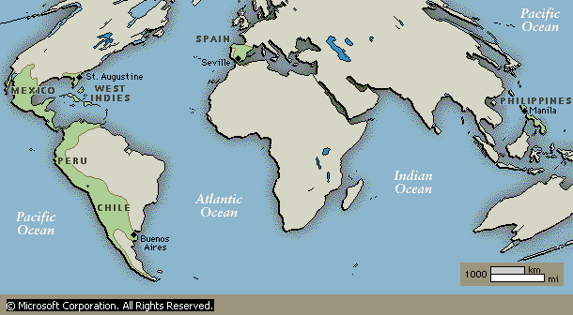
Spanish Empire
Establishment of feudal and manorial systems in America
Importation of African slaves to replace decimated Indians
Stratified society based on Iberian connections and race

Slide 11
Economic Impact of Conquests
Age of Inflation
  Annual treasure fleets took gold and silver from America to Spain in 16th and 17th centuries
  Increased quantity of currency in Europe led to general rise in prices
  Population increase explains increase in food prices but not general price increase

