Slide 1
Western Civilization Since 1500
Lecture 7: Catholic Reformation

Slide 2
New Religious Orders
Capuchins (1520, 1528): rejuvenation of Franciscan ideal
Theatines (1524): moral reform
Ursulines (1535): education and charity

Slide 3
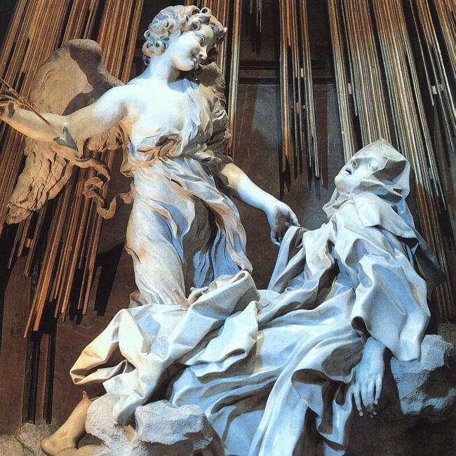
Mysticism
Ambiguity in Church tradition
St. Teresa of Avila (1515-1582)
  “Reformed” Carmelite
  Contemplative Prayer

Slide 4
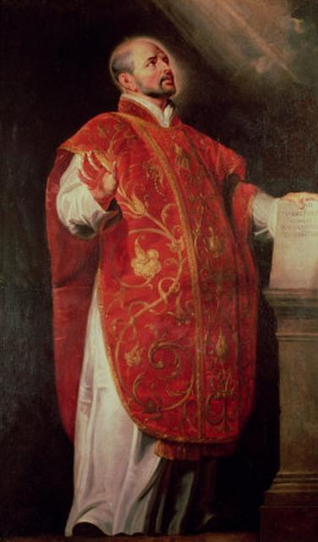
Jesuit Order
St. Ignatius of Loyola (1491-1556)
Society of Jesus (1540)
Spiritual Exercises
Evangelism: St. Francis Xavier

Slide 5
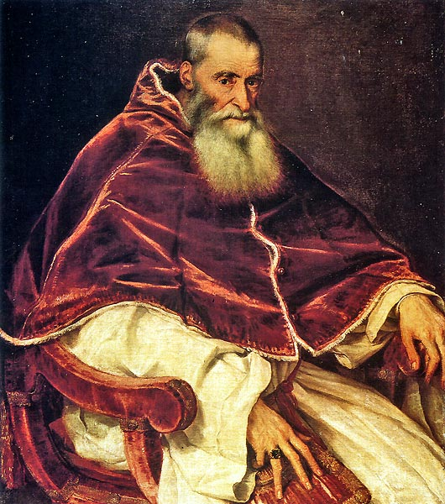
Revived Papacy
Paul III, 1534-1549
  Reform commission
  Recognized the Jesuits
  Called the Council of Trent
Paul IV, 1555-1559
  Strengthened Inquisition
  Index of Prohibited Books

Slide 6
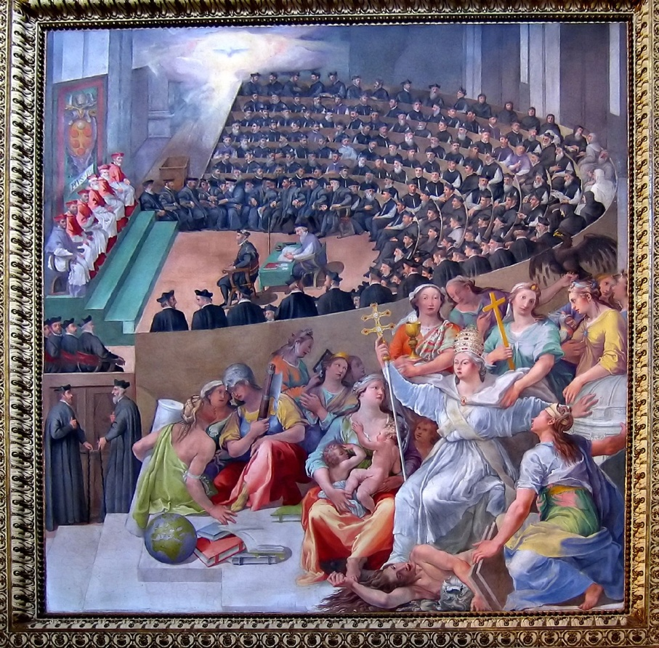
Council of Trent (1545-1563)
Continuation of Paul III’s reform efforts
Reaffirmed traditional teachings
Reformed abuses (e.g., indulgence sales)
Liturgical reform

Slide 7
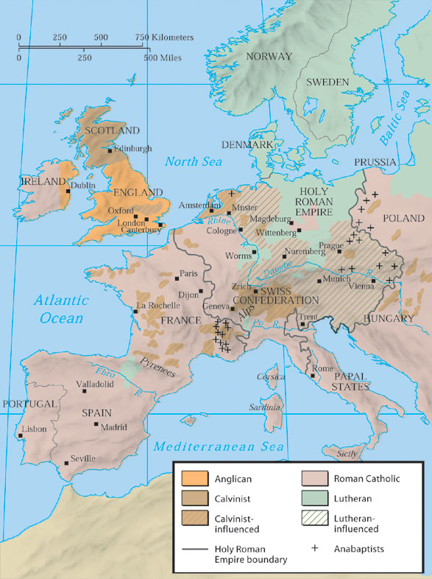
©2003 Wadsworth, a division of Thomson Learning, Inc. Thomson Learning™ is a trademark used herein under license.
Catholics and Protestants in Europe in 1560

