Slide 1
Western Civilization Since 1500
Lecture 6: English Reformation

Slide 2
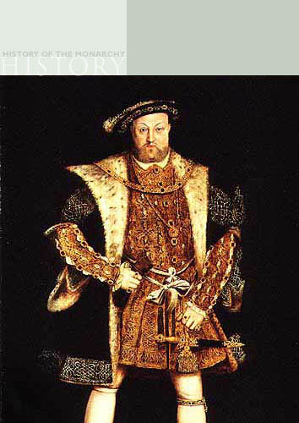
England: Henry VIII (1509-1547)
Defence of the Seven Sacraments (1521)
Marriage to Catherine of Aragon
Succession issue
Anne Boleyn

Slide 3
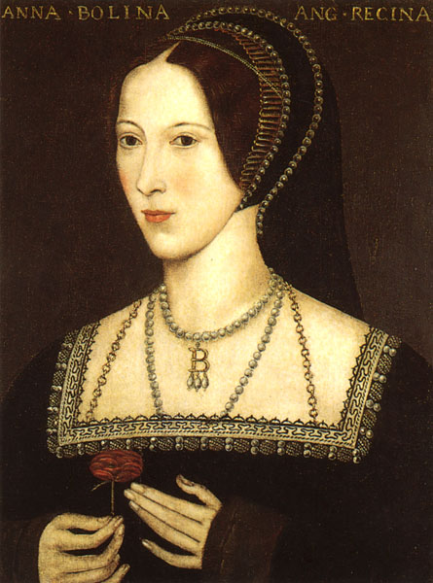
England: Henry VIII (1509-1547)
Divorce/annulment attempts
  Clement VII
  Charles V
“Reformation Parliament” (1529-1536) and praemunire
Henry’s six wives

Slide 4
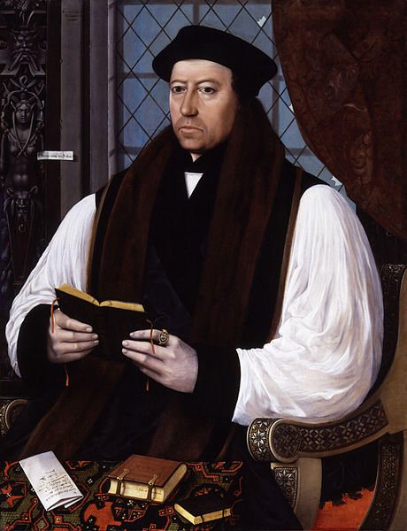
Doctrinal Tension
1530s
  Cranmer/Cromwell
  Dissolution of Monasteries (1536)
  Ten Articles
1539-1547 – Reaction; Six Articles

Slide 5
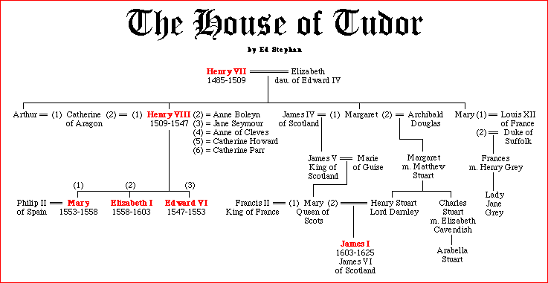
Tudor Genealogy

Slide 6
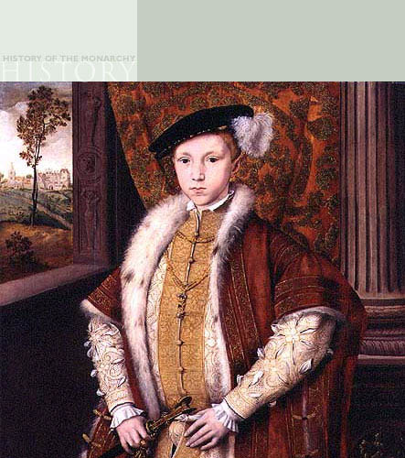
Edward VI (1547-1553)
Regency government
“Calvinized” the Church of England
New English liturgy: Book of Common Prayer
Died at age 15

Slide 7
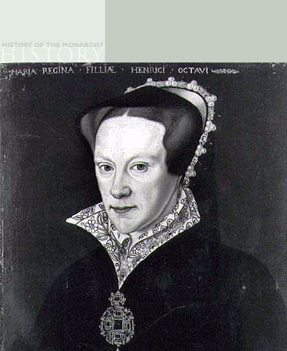
“Bloody Mary” (1553-1558)
Restoration of Roman Catholicism
Persecution of Protestants; “fires of Smithfield”
Marriage to Philip II

Slide 8
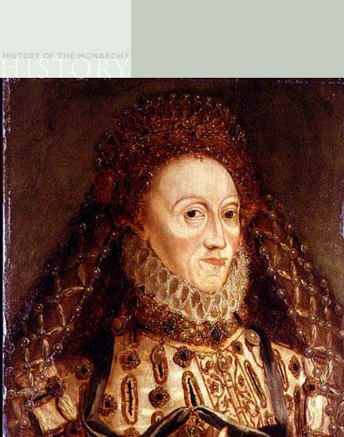
Elizabeth I (1558-1603)
“Virgin Queen”
Act of Uniformity
  Book of Common Prayer
  Thirty-Nine Articles
Catholics, Puritans and the via media
Excommunication by pope, assassination attempts

