Slide 1
Western Civilization Since 1500
Lecture 5: Swiss Reformation and Anabaptists

Slide 2
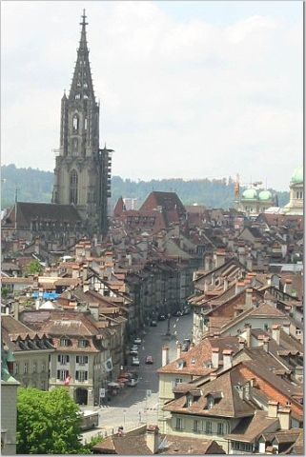
Switzerland
Rugged geography conducive to decentralized politics
Main export: mercenaries
Thirteen cantons in a loose federation

Slide 3
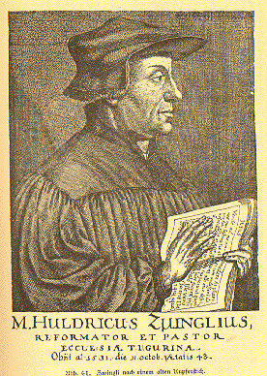
Huldrych Zwingli (1484-1531)
Zurich preacher with humanist background
Reached conclusions similar to Luther’s independently
Began preaching directly from N.T.
1524 – Zurich magistrates abolish Mass

Slide 4
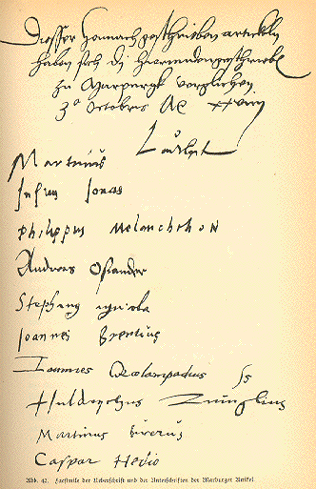
Marburg Colloquy (1529)
Efforts to unite Lutherans and Zwinglians
Impasse over the Eucharist
  Luther – consubstantiation
  Zwingli – purely symbolic
Attempt at unity failed

Slide 5
Swiss Politics
During the 1520s, a majority of the cantons became Protestant
10/1531 – fighting; Zwingli killed in battle
Peace of Kappel (11/20/1531) – each canton chooses religion; Catholic minorities tolerated
Heinrich Bullinger (1504-1575) succeeded Zwingli as Protestant leader

Slide 6
Anabaptists
Conrad Grebel (1498-1526)
  Zurich citizen
  Rejected civil authority in religious affairs (1523)
  Rejected infant baptism (1525)
Strong antinomian streak
1526 – Zurich makes rebaptism capital crime
Opponents linked them with Peasant Revolt

Slide 7

Anabaptists
Schleitheim Statement (1527)
  Baptism for repentant adults (not for remission)
  No communion for unbaptized
  Baptized to separate themselves from evil world
  No arms-bearing or oath-taking
Munster Incident – Jan of Leiden (1534-1536)
Menno Simons (1496-1561) and pacifism

Slide 8
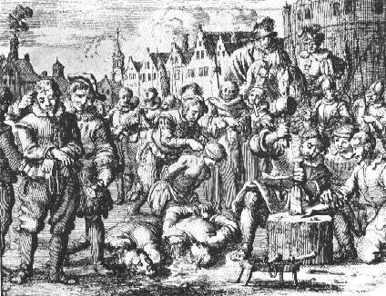
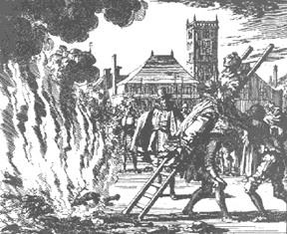
Persecution of Anabaptists

Slide 9
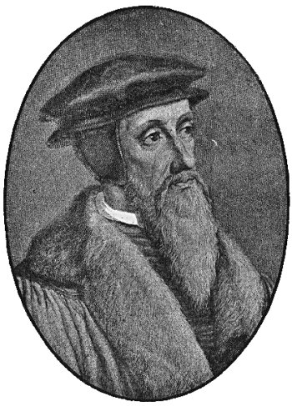
John Calvin (1509-1564)
Frenchman with legal and humanistic training
Became a Protestant in early 1530s
Fled France, wound up in Basel
1536 – Institutes of the Christian Religion

Slide 10
John Calvin (1509-1564)
Theology
  Sovereignty of God
  “Spiritual” presence in Eucharist
  Obedience to God’s law, individually and socially
  Doctrine of the “lesser magistrates”

Slide 11
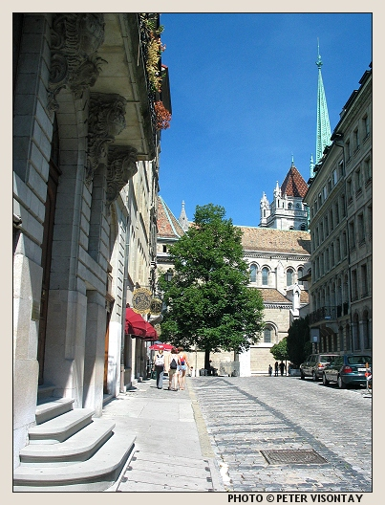
Calvin in Geneva
1536 – Calvin is asked to help reform
Pushed for church oversight and discipline of flock
Church works with State to reform
Michael Servetus Case (1553)

Slide 12
Spread of Calvinism
Theodore Beza (1516-1605) and the Genevan Academy
French Huguenots
John Knox (1505-1572) and Scotland
The Netherlands
American colonies

