Slide 1
Western Civilization Since 1500
Lecture 4: German Reformation

Slide 2
Papacy’s Struggles
Decline of papal prestige after 1300
  “Babylonian Captivity”
  Great Schism
  Challenges to papal authority
Council of Constance
Renaissance popes
  Alexander VI
  Julius II

Slide 3
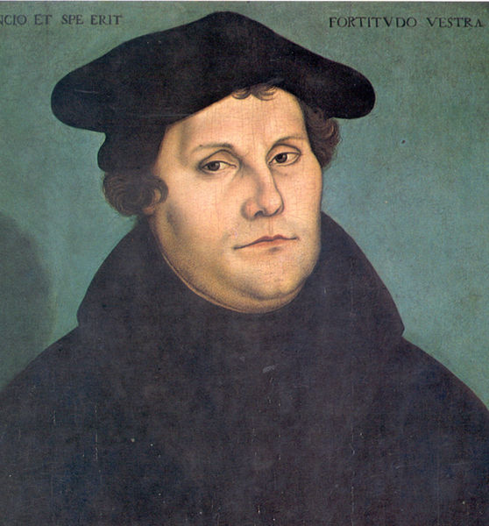
Martin Luther (1483-1546)
Background
Professor at University of Wittenberg
Theological development
  Sola fides
  Sola scriptura

Slide 4
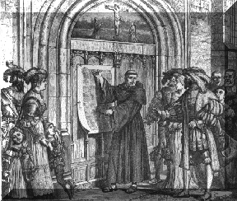
Conflict with Authority
John Tetzel and indulgence sales
10/31/1517—95 Theses
Role of printing press
October 1518—heresy examination in Augsburg

Slide 5
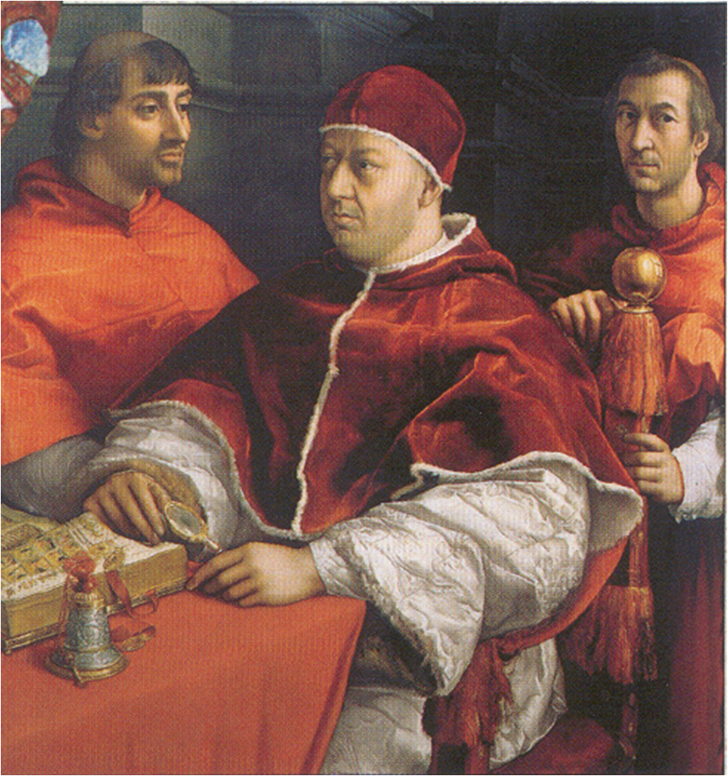
Conflict with Authority
Summer 1519—Leipzig debate
1520 tracts
  Address to the Nobility of the German Nation
  The Babylonian Captivity of the Church
  The Freedom of a Christian Man

Slide 6
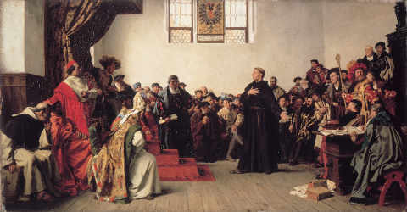
Conflict with Authority
1520—Excommunication
1521—Diet of Wörms
Wartburg Castle
Translation of New Testament into German

Slide 7
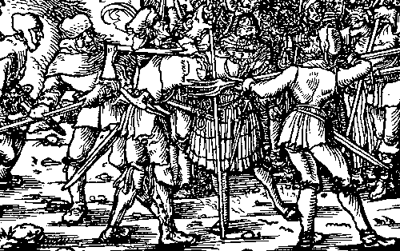
Conflict with Radicals
Andreas Karlstadt in Wittenberg
1522—Luther returns
Thomas Müntzer and the Peasant Revolt (1524-1525)

Slide 8
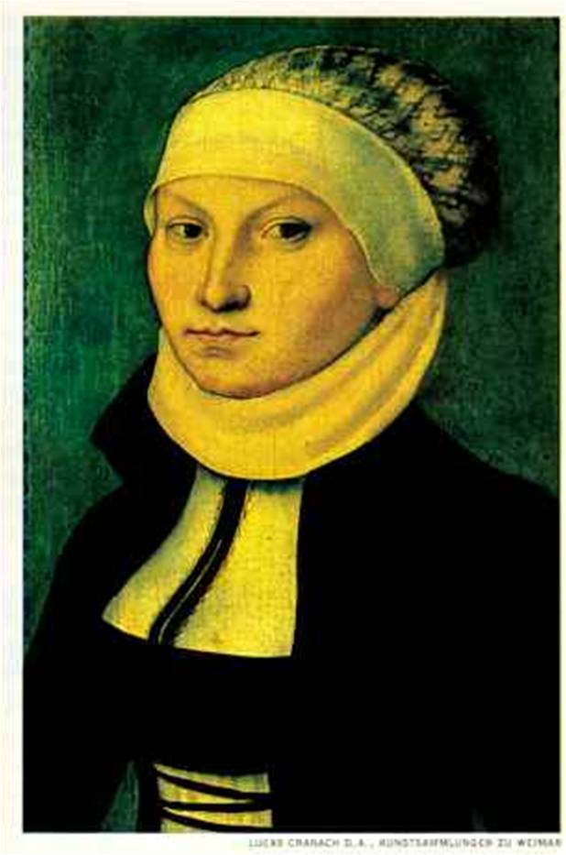
A New Order
Abolition of monastic houses
Marriage to Katharina von Bora
Vernacular worship
Images, candles, etc.
Translation of OT

Slide 9
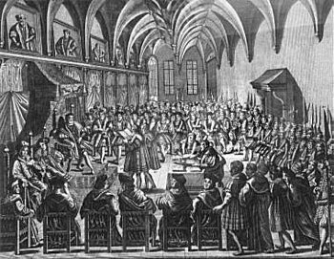
Protestants
Supporters throughout northern Germany
1529—Second Diet of Speyer
1530—Diet of Augsburg
Schmalkaldic League

Slide 10
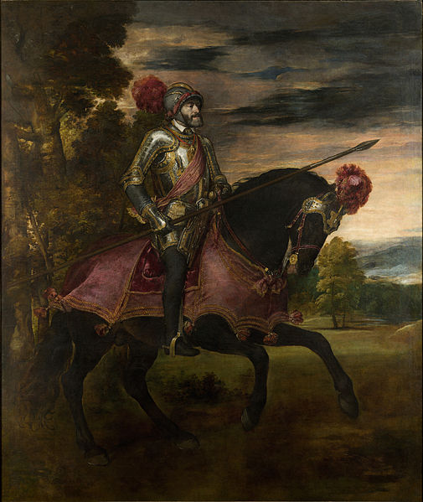
Conflict with Charles V
Delays in attention to Protestants
  War with France
  War with Turks
  War with pope
Schmalkaldic Wars (1546-1552)
1555—Peace of Augsburg

