Slide 1
Western Civilization Since 1500
Lecture 3: Northern Renaissance

Slide 2
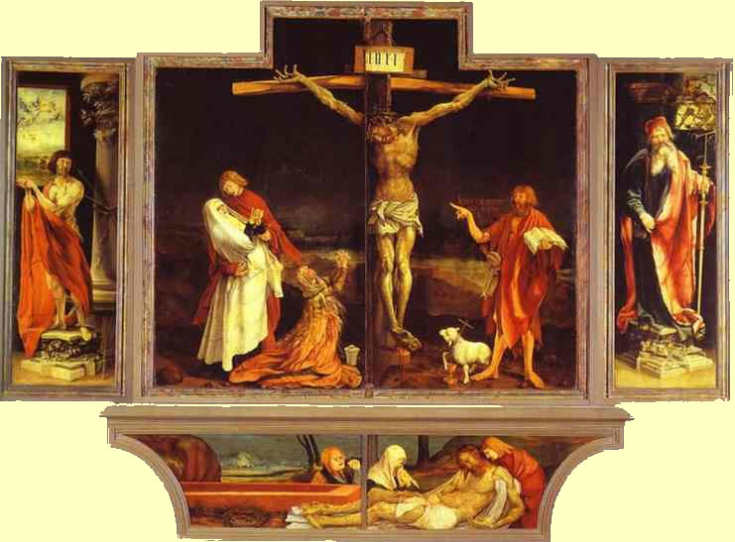
Northern Renaissance
Italian humanism moves slowly north after 1450
Differences
  Not so Greco-Roman
  Greater concern with Christian issues
  More realism in art

Slide 3
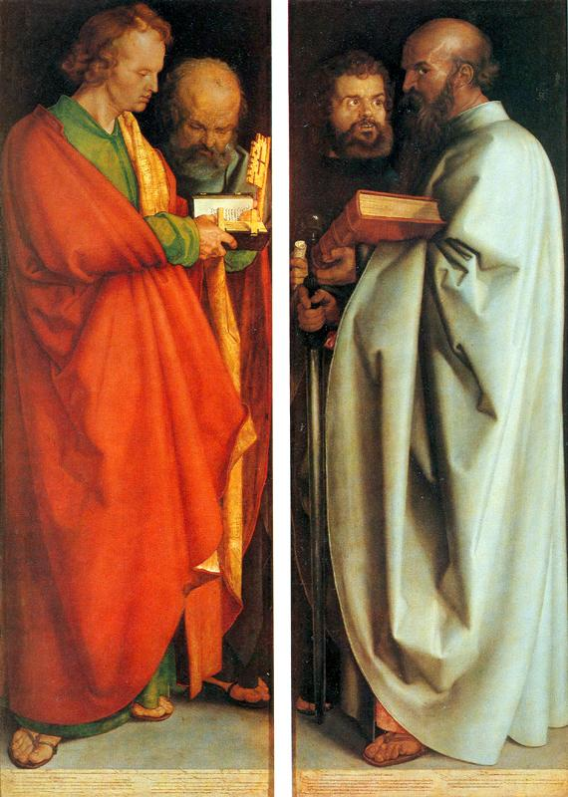
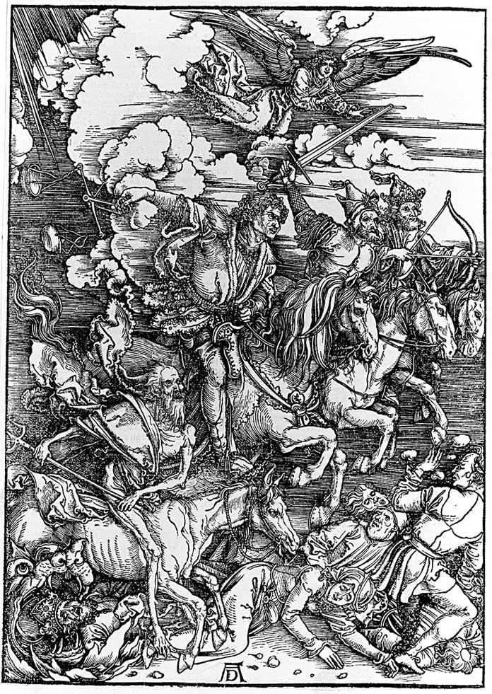
Albrecht Durer (1471-1528)

Slide 4
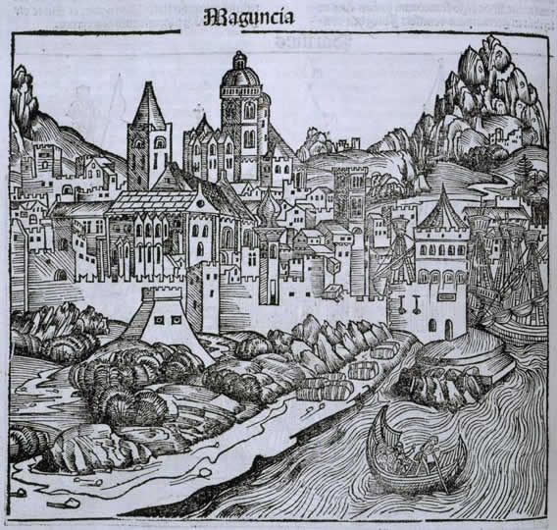
The Printing Press
Johann Gutenberg (c. 1395-1468) and Mainz
Movable metal type (1450)
Impact
  Mass production
  Lower prices
  Wider literacy

Slide 5
Northern Humanism
Same interest in style and rhetoric as in Italy
Focus on Scripture and Church Fathers instead of Greco-Roman pagans
Johann Reuchlin (1455-1522) and the Kabala

Slide 6
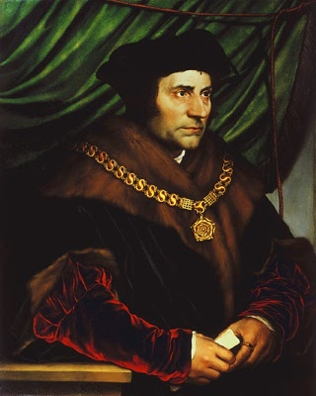
Thomas More (1478-1535)
English humanist
Speaker of House of Commons, Chancellor
Executed in 1535
Utopia (1516)

Slide 7
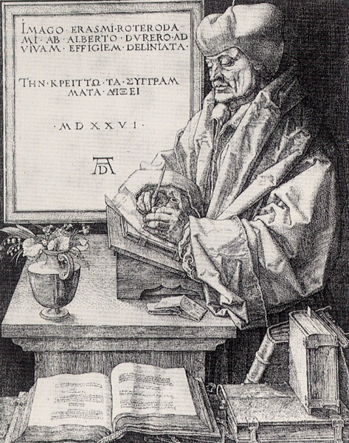
Desiderius Erasmus (c. 1467-1536)
The greatest scholar of the Renaissance
A sharp critic of simony, the cult of the saints, etc.
Bestselling author
  Enchiridion
  The Praise of Folly
  Julius Exclusus

Slide 8
Erasmus and the Bible
“The Philosophy of Christ” – a moralist view of religion
Emphasized the “three languages”: Latin, Greek, and Hebrew
New translation of N.T. into Latin from the Greek in 1516
  Example of humanistic textual criticism
  Matt. 4:17 – “Do penance” or “be penitent”?

