Slide 1
Western Civilization Since 1500
Lecture 2: Renaissance Humanism

Slide 2
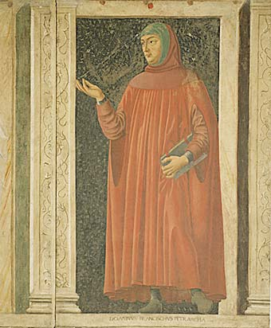
Petrarch and History
Medieval concept of antiquity
Francesco Petrarca (1304-1374)
  Realization that the classical world was gone
  Posited a “Dark Age”
Jacob Burckhardt et al

Slide 3
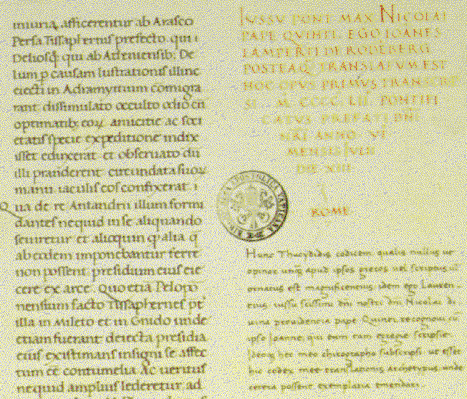
“Revival” of Antiquity
Discovery of manuscripts (14th c.)
Interest in Greek
New way of viewing classics
Textual criticism
  Valla and the Donation of Constantine
Lorenzo Valla’s translation of Thucydides

Slide 4
The Studia Humanitatis
Reaction to the Scholastics’ curriculum
  Trivium and Quadrivium
  The three professions
The “liberal arts” to produce l’uomo universale
  Petrus Paulus Vergerius: “The New Education”
  Focus on citizenship, public service
  Considered more “practical”

Slide 5
The Studia Humanitatis
Subjects
  Grammar
  Rhetoric
  Poetry
  Moral philosophy
  History
Scholastic/humanist rivalry

Slide 6
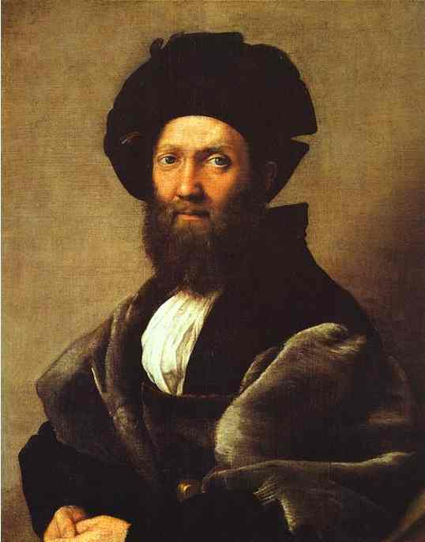
The Courtier (1528)
Baldassare Castiglione (1478-1529)
Qualifications
  Martial
  Scholarly
  Sprezzatura

Slide 7
Civic Humanism
Literary talents serve the State
Tried to revive greatness of republican Rome
Coluccio Salutati (1331-1406)
Niccolo Machiavelli (1469-1527)

Slide 8
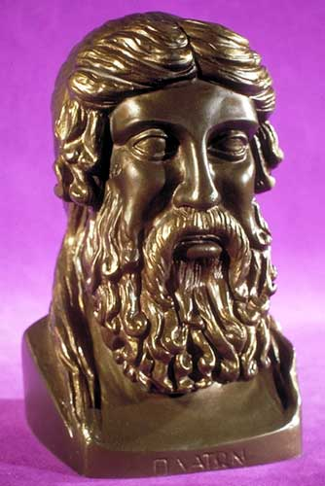
Revival of Plato
Medieval emphasis on Aristotle
Many humanists championed Plato
  Marsilio Ficino
  Pico della Mirandola
The “Dignity of Man”
Attempted synthesis

Slide 9
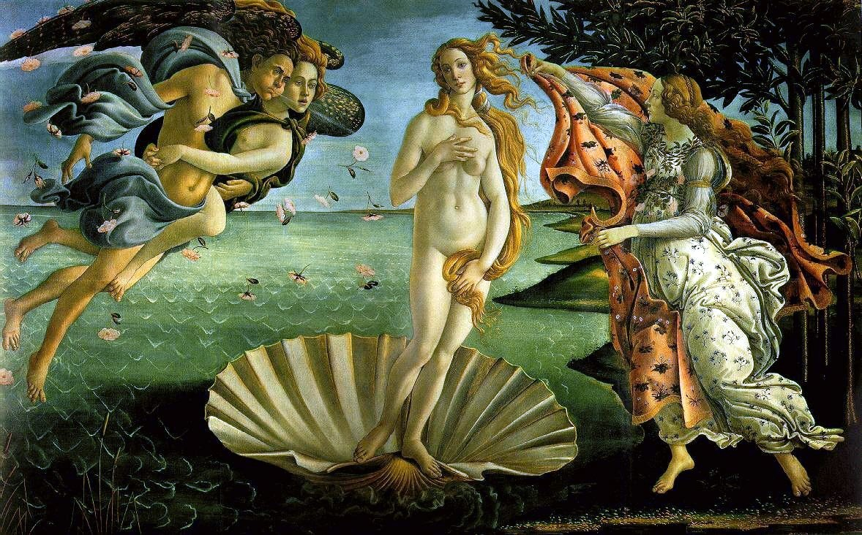
Humanism in the Arts
Classical and neo-pagan influences
Canon of proportions
Art for art’s sake
Leon Battista Alberti: On Painting
Sandro Botticelli: Birth of Venus

Slide 10
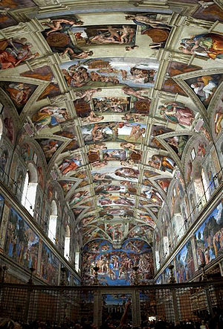
Humanism in the Arts (2)
Leonardo da Vinci and empirical emphasis
Michelangelo Buonarotti and Platonic philosophy: Sistine Chapel
Rafael Sanzio and classicism: School of Athens

Slide 11
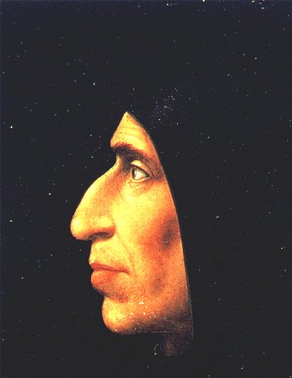
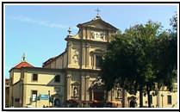
San Marco
Savonarola

Slide 12
Savonarola
Dominican friar and popular preacher
Moral reformer; condemned papal and Medici decadence
De facto ruler of Florence, 1494-1498
“Bonfire of the Vanities” (1497)
Torture and execution (1498)

