Slide 1
Western Civilization Since 1500
Lecture 1: Introduction; Italian Renaissance Society and Economy

Slide 2
Pre-1500 Background
Foundations of Western Civilization
  Hebrews
  Greeks
  Romans
Medieval Synthesis
  Christianity
  Greco-Roman Legacy
  Germanic People

Slide 3
Course Overview
Lectures 1-9: Renaissance/Reformation
Lectures 10-16: 17th-18th Centuries
Lectures 17-27: Revolutionary Era
Lectures 28-31: Fin de Siecle
Lectures 32-38: World Wars
Lectures 39-42: Postwar West

Slide 4
Italian Renaissance
Renaissance: rebirth (of classical culture)
14th-16th century Italy
  Recovery from Black Death
  Wealth ➔ High Culture
Birth of the modern?
  Jacob Burckhardt
  Revisionists

Slide 5
Italian Society/Economy
Urban character of Italy
Modified forms of feudalism and manorialism
Commercial economy in Middle Ages
  Position along trade routes
  Merchant fleets
  Domestic industry (Florence – wool; Venice – glass)

Slide 6
City-State Politics
Formation of communes in the Middle Ages
Trend in 14th-15th c.: republic ➔ despotism
Innovations in diplomacy
New model for the state: illegitimate authority
Machiavelli and The Prince

Slide 7
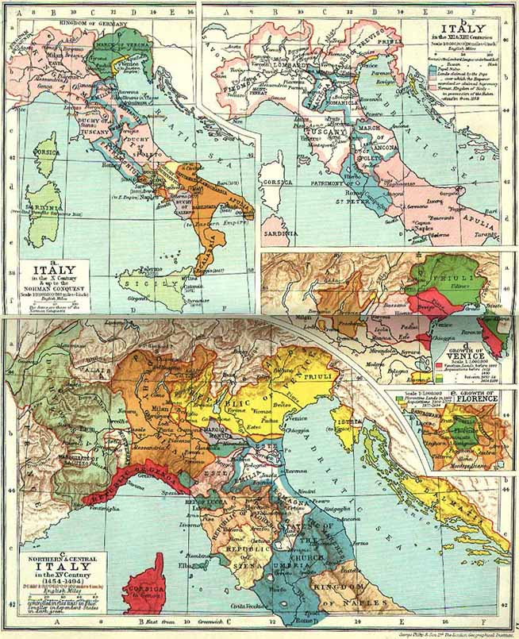

Slide 8
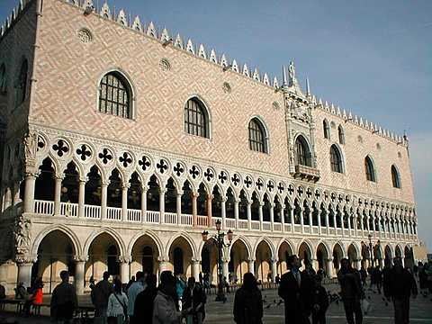
The Five Major States
Naples: traditional feudal monarchy
Papal States: ruled directly by the pope
Florence
  Banking and wool
  Republic (Medici)
  Lorenzo the Magnificent

Slide 9
The Five Major States
Milan
  Early despotism
  Strongest land power
  Wars with HRE
Venice
  Maritime empire
  Extensive trade networks with the East
  Remained a republic until 1806

Slide 10
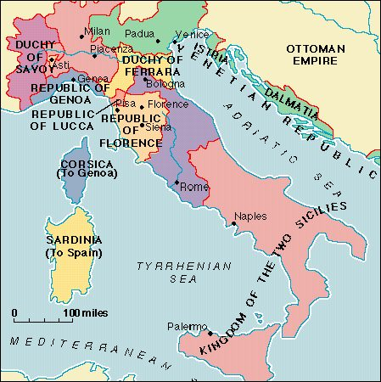
Conflict
Regular small-scale warfare in 15th c.
Peace of Lodi (1454) ushered in forty years of relative peace
1494 – Milan brings in the French
1527 – Sack of Rome by Charles V

