Slide 1
Western Civilization to 1500
Lecture 42: Late Medieval Church

Slide 2
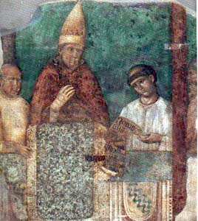
Decline of Papal Power
Primacy, 11th-13th c.
  Innocent III
  Secret weapon: rebellious nobles
Increased royal power by 1300
Boniface VIII (1294-1303) vs. Philip IV of France
“Unam Sanctam”

Slide 3
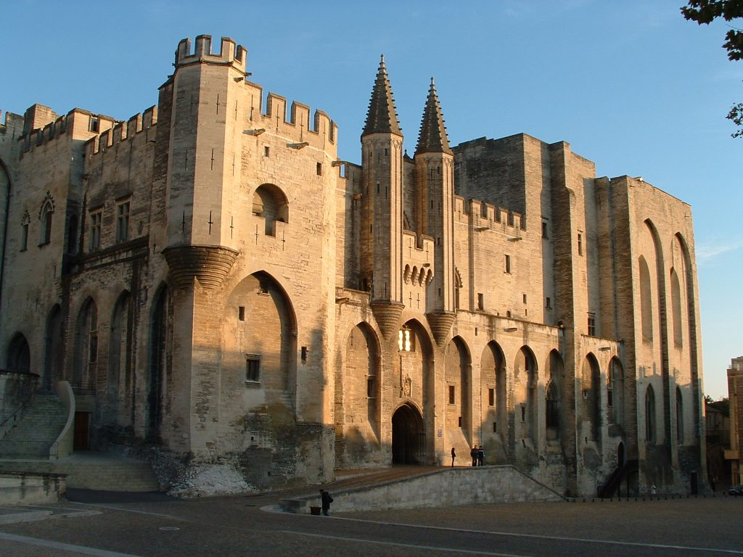
Babylonian Captivity
Clement V (1305-1314)
  Frenchman
  Moved to Avignon
Remains till 1376
All French popes
Building projects
Loss of prestige
  Primarily fundraisers
  Pawns of the French?

Slide 4
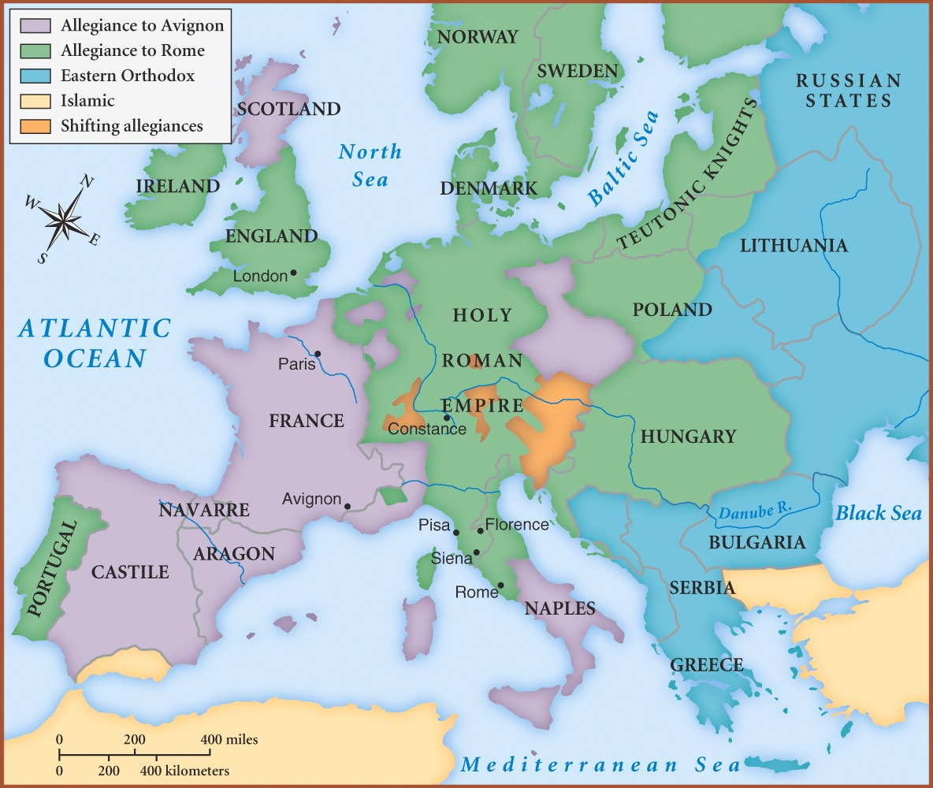
The Great Schism
Gregory XI (d. 1378)
Pressure for Italian pope
Urban VI (1378-1389)
Cardinals renege, elect French pope
Division until 1417
Conciliar theory
  Council of Pisa (1409)
  Council of Constance (1414-1418)
Martin V (1417-1431)

Slide 5
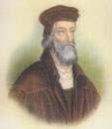
Challenges to Papal Authority
William of Ockham (c. 1290-1349) and nominalism
John Wycliffe (c. 1328-1384)
  Translated Bible
  Rejected sacraments
  Secular control

Slide 6
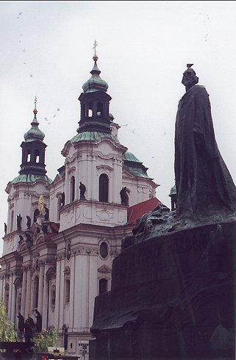
Challenges to Papal Authority
Jan Hus (c. 1369-1415)
  Agreed with Wycliffe
  Communion in 2 kinds
  Condemned sale of indulgences
  Burned at Constance
Hussite Rebellion until 1436

Slide 7
The Imitation of Christ
Thomas a Kempis (1380-1471)
Brothers of the Common Life
  Devotional movement
  Common in N. Europe in 15th century
Believers should follow personal example of Christ
  Humility, self-denial
  Friendship with Jesus, taking up the cross

Slide 8
Conclusion
Foundations
  Hebrew theology
  Greek rationality
Roman consolidation
  Assimilation to Greek culture
  Conversion to Christianity
Medieval synthesis: Athens and Jerusalem

