Slide 1
Western Civilization to 1500
Lecture 41: The Fourteenth-Century Crisis

Slide 2
The Calamitous 14th Century
Europe in 1300
“Little Ice Age”
  Climatic changes; cooler temperatures
  Shorter growing season
  Heavy storms
1315-1317 famine

Slide 3
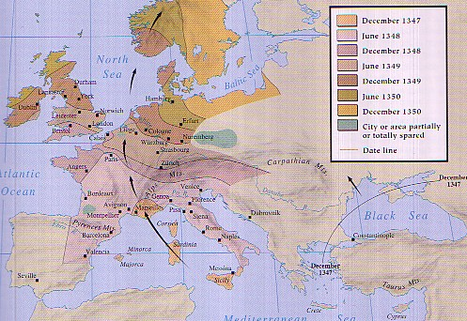
The Black Death
Bubonic plague, rats, and fleas
Origins and transmission
First wave: 1347-50
Death toll
  25-50% of population
  Cities vs. villages

Slide 4
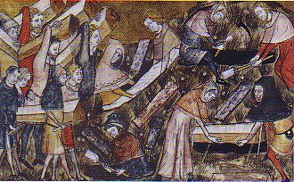
The Black Death: Reactions
Search for meaning
Decameron’s depiction
  Setting of work
  Extremes of behavior
Art
  Guilds wiped out
  Focus on death

Slide 5
Dislocation and Upheaval
Social consequences of plague
  Labor shortage and mobility
  Aristocratic reaction: Statute of Laborers
  Breakdown of manorial obligations
Revolts
  Jacquerie (1358)
  English Peasants’ Revolt (1381)
  Urban revolts – Ciompi (1378)

Slide 6
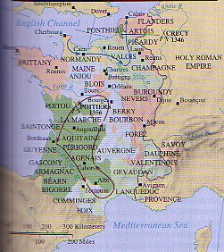
Hundred Years War (1337-1453)
Edward III v. Philip VI
Changing warfare
  Crecy (1346)
  Poitiers (1356) and Peace of Bretigny (1359)
  Henry V and Agincourt (1415)
Joan of Arc (1412-30)
Conclusion

Slide 7
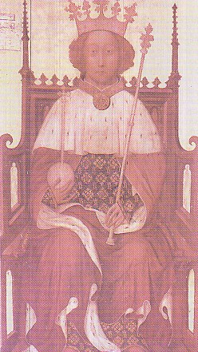
Political Instability
England – Richard II and Parliament
French kings vs. Burgundian dukes
Holy Roman Empire – Golden Bull (1356)
Italian city-states – move to despotism

