Slide 1
Western Civilization to 1500
Lecture 40: Medieval Monarchies

Slide 2
Review of Feudalism
Lord grants a benefice (or fief) to a vassal
Vassal performs (military) service for the lord in return
Subinfeudation—vassal divides his fief and distributes it to other vassals, becoming their lord
Decentralized structure—local control

Slide 3
Rise of National Monarchy
England
France
Spain
Holy Roman Empire (Germany)

Slide 4
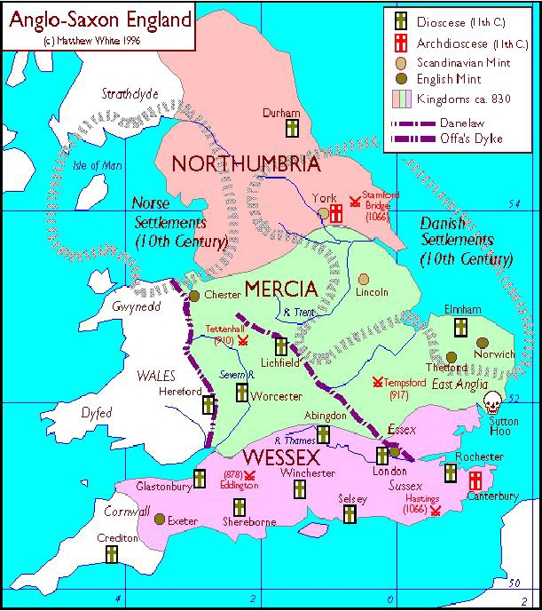
England
Anglo-Saxon Period (to 1066)
“Heptarchy”—seven small kingdoms gradually consolidated
Viking invasions (9th century)
Alfred the Great (871-899)
  Stopped the Vikings
  Mini-Renaissance
  Foundations of common law

Slide 5
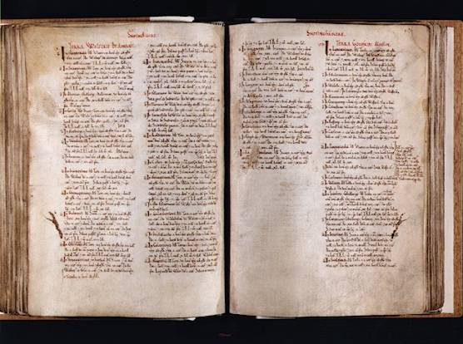
England (2)
Norman Conquest (1066)
  William “the Conqueror”
  Battle of Hastings
Centralization of power
  Liege homage
  Shire-reeves (sheriffs)
  Domesday Book

Slide 6
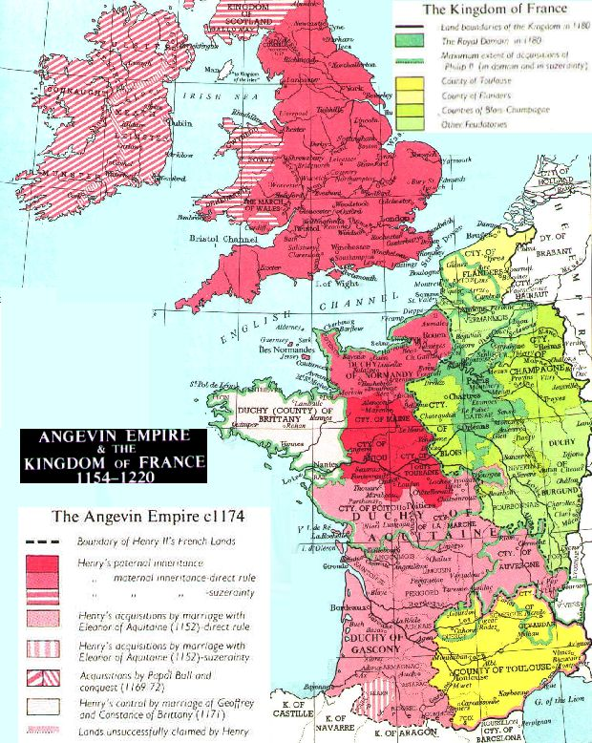
England (3)
Plantagenet Dynasty (1154-1485)
  Henry II (1154-1189)
    Angevin Empire
    Common law
  Richard I (1189-1199) and Crusades
  John (1199-1216)
    Wars with France
    Struggles with Innocent III
    Magna Carta (1215)

Slide 7
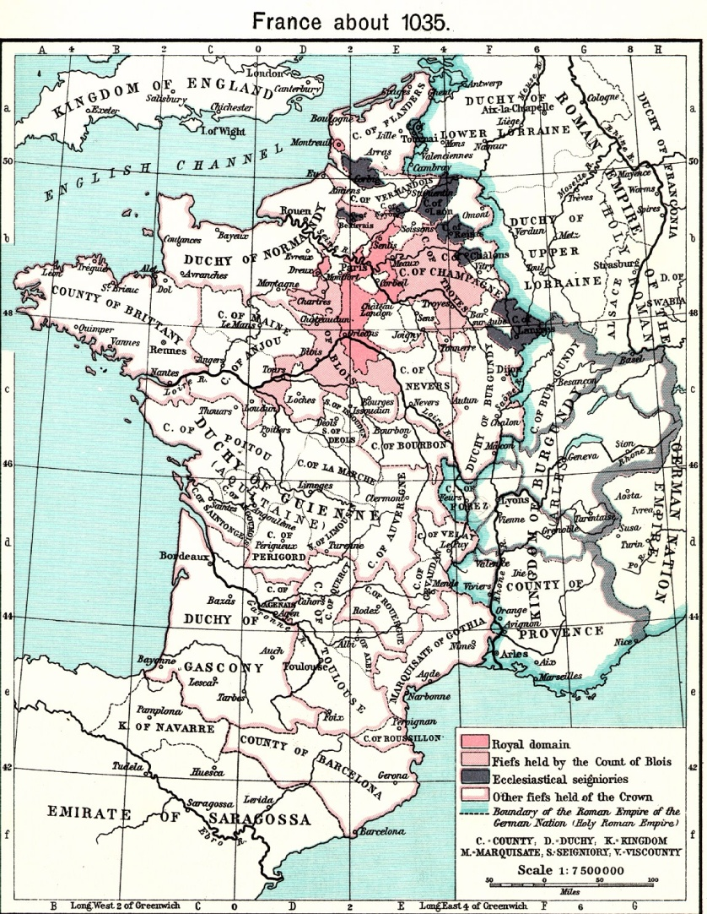
France—Capetian Dynasty
Hugh Capet (987-996)—weakness
Louis VI (1108-1137)—expansion
Philip Augustus (1180-1223)
  Wars with Plantagenets
  Albigensian Crusade
Louis IX (1226-1270)—ideal monarch
Philip IV (1285-1314) and Boniface VIII

Slide 8
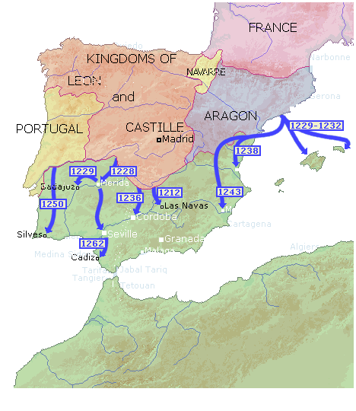
“Spain”
Visigoth Kingdom (5th century)
Arab Conquest (711)
Reconquista
Major kingdoms
  Castile-Leon
  Aragon
  Portugal

Slide 9
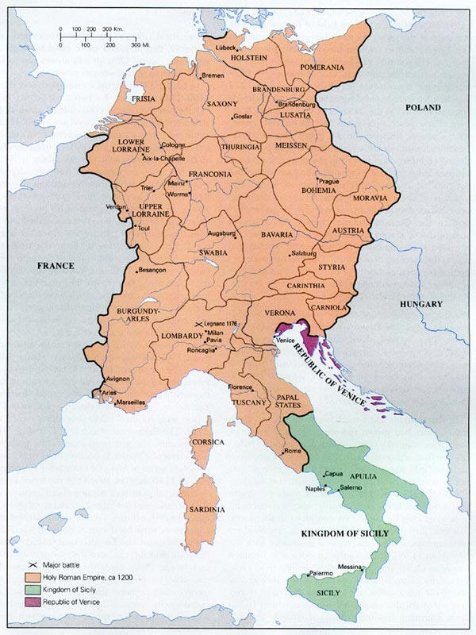
Holy Roman Empire
Otto I “the Great” (936-973)
  Church relations
  Imperial title (962)
Italy or Germany?
Hohenstaufens
  Frederick I “Barbarossa” (1152-1190)
  Frederick II (1215-1250)

Slide 10
Representative Assemblies
Originated in medieval period
Features
  Kings seek support from landed classes and wealthy townsmen
  “Extraordinary” taxes require consent
Castilian cortes
French Estates-General
English parliament (Henry III vs. Simon de Montfort)

Slide 11
Revival of Roman Law
Rediscovery of Justinian’s Corpus Iuris Civilis
Growing sophistication of legal commentaries
Contrast to Germanic and feudal custom
Popularity with rulers

