Slide 1
Western Civilization to 1500
Lecture 39: Universities and Scholastic Philosophy

Slide 2
12th-century Renaissance
Resurgence of interest in classical works
Translation of numerous Greek works (often via Islamic world)
Adaptation of Arabic science

Slide 3
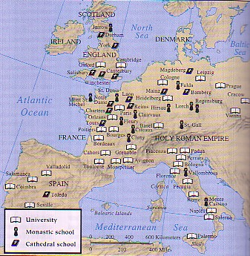
Rise of Universities
Universitas – guild
Monasteries ➔ cathedral schools ➔ universities
Early universities
  Salerno? – medicine
  Bologna – law
  Paris – theology

Slide 4
University Curriculum
Trivium and quadrivium
Lecture style
Examinations
Artium baccalarius and artium magister
The professions
  Medicine
  Law
  Theology

Slide 5
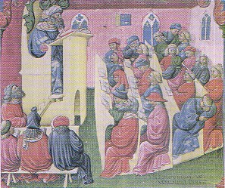
Student Life
Backgrounds – middling groups
Good students, bad students
Student/teacher relations (Bologna, Paris)
School violence

Slide 6
Scholasticism
Reconciliation of faith and reason
Syllogistic (deductive) reasoning
  Major premise: All men have souls
  Minor premise: Socrates is a man
  Conclusion: Socrates has a soul
Fourfold interpretation of Scripture

Slide 7
Scholasticism (2)
Prominent scholastics
  Anselm (1033-1109) – ontological proof
  Peter Abelard (1079-1142)
    Relationship with Heloise
    Sic et non
  Peter Lombard (fl. 1150) – Sentences

Slide 8
Thomas Aquinas (1225-1274)
Dominican friar
Taught in Italy and Paris
Devoted to Aristotle
Greatest work: Summa Theologica
Natural Law and the Human Good

