Slide 1
Western Civilization to 1500
Lecture 35: The Aristocracy

Slide 2
Feudalism
Political arrangement of the Middle Ages
Lord grants a benefice (or fief) to a vassal
Vassal performs (military) service for the lord in return
Subinfeudation—vassal divides his fief and distributes it to other vassals, becoming their lord
Decentralized structure—local control

Slide 3
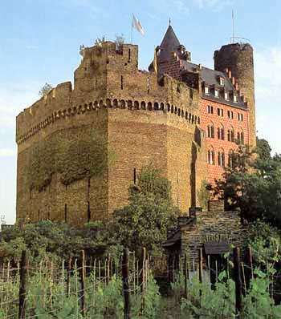
Aristocratic Roles
Defenders of society
Wield political power
Private warfare and castles
Clergy’s reforms
  “Peace of God”
  “Truce of God”
  Crusades

Slide 4
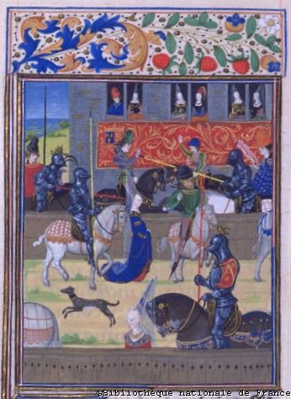
Warriors’ Training
Stages
  Page (7)
  Squire (14)
  Knighting (21)
Tournaments
  Melee
  Joust

Slide 5
Code of Chivalry
Church’s attempt to tame nobility
Tenets
  Prowess
  Loyalty to one’s lord
  Serve the Church faithfully
  Respect all women

Slide 6
Cult of Courtly Love
Andreas Capellanus: De Amore
Love=passion, secret and unconsummated
Devote oneself to a lady (preferably married) above one’s station
Rules of Love
  Impossible between husband and wife
  Must be difficult to obtain
  Lover must be jealous

Slide 7
Medieval Epic
Long narrative poem
Story of heroes and great deeds
Designed to be heard, not read
Often served as “national history”

Slide 8
Medieval Epics
Beowulf
Song of Roland
El Cid
Lancelot
Sir Gawain and the Green Knight
Romance of the Rose

