Slide 1
Western Civilization to 1500
Lecture 34: Medieval Society and Economy: Urban Life

Slide 2
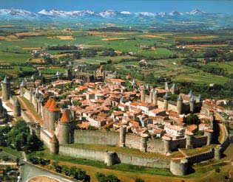
Urban Revival
Town origins
  Roman
  Fortifications
  Cathedral
Common features
  Walls
  Marketplace
  Court

Slide 3
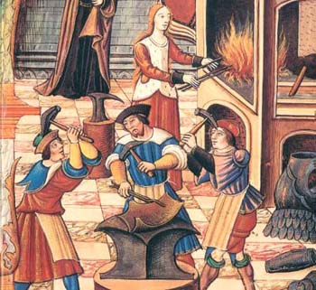
Guild System
Trade associations with political role
Types
  Merchant
  Craft
Town liberties
Fraternal functions

Slide 4
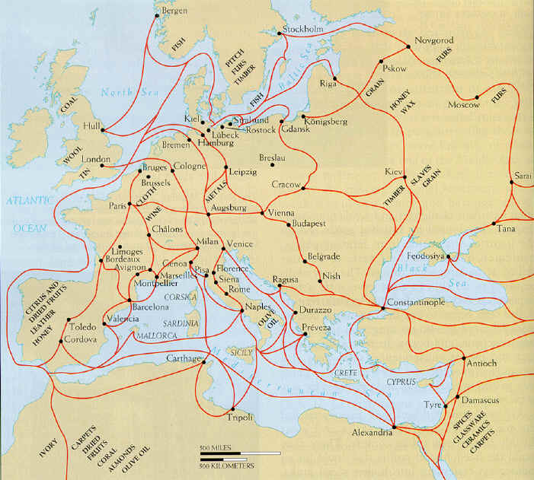
Long-Distance Trade
Risks of travel
Merchants share risks
Trade fairs
Key trade centers
  Italian cities (esp. Venice)
  Flemish cities

Slide 5
New Business Procedures
Money economy (lack of money?)
Distinct types of merchants: sedentary, carriers, agents
Correspondence and accounting: courier services, “road revolution,” credit system (and usury debate)
Leaders: Italian cities, Hanseatic League

