Slide 1
Western Civilization to 1500
Lecture 33: Medieval Society and Economy: Peasants

Slide 2
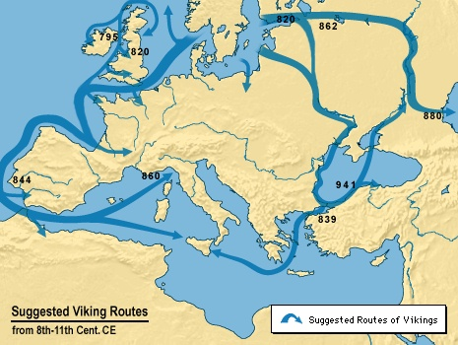
The Tenth Century
Breakdown of Charlemagne’s empire
Invasions by Vikings, Arabs, Magyars
Loss of trade, communications

Slide 3
1000 – The Turning Point
Population increase
  38 to 74 million in 300 years
  More villages, towns, cities, farms
  Reasons
    Increased security
    Agricultural production

Slide 4
New Agriculture
Warmer climate, longer growing season
Increase in amount of arable land, clearing of forests
Crop rotation: 2-field to 3-field
Technological advance: horse collar, windmill

Slide 5
The Three Estates
Clergy: “Those who pray”
Aristocracy: “Those who fight”
Peasants: “Those who work”

Slide 6
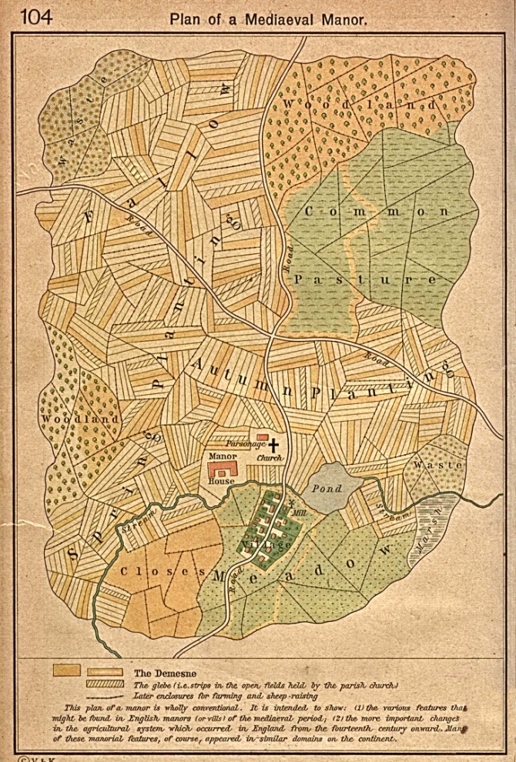
Manorialism
Manor—self-sufficient estate owned by a lord
Estate features
  Manor house
  Village
  Fields
  Commons
  Forest/waste

Slide 7
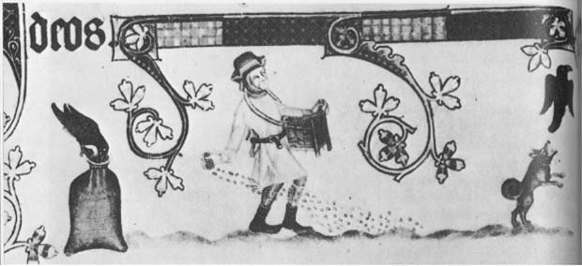
Peasant Life
Seasonal labors
Catholic feast days
  Christmas
  Easter
  Pentecost
Village church
  Sacraments
  Question of understanding
Notes:
The peasant’s life was regulated by the flow of the seasons and the different agricultural tasks required in each one (plowing, planting, harvesting, etc.).
Most peasants worked every day, but the frequency of holy days in the church calendar (around 100 per year), during which no work was done, gave them an average of nearly two days of rest per week. Christmas (birth of Christ), Easter (resurrection of Christ), and Pentecost (beginning of the Church) were the most important holidays.
Peasants took part in religious life primarily through the seven sacraments of the Church (baptism, confirmation, communion, penance, matrimony, ordination, and last rites), mediated by the village priest. It is doubtful whether most peasants understood much Christian doctrine beyond bare essentials.

Slide 8
Peasant Life (2)
Houses
  Wood/wattle or stone
  One- or two-room
Gender roles
Diet
Vivid depiction of Piers Plowman
Notes:
A wattle is a collection of flexible sticks, branches, or twigs woven together and packed with mud or similar to make fences, walls, and roofs.
The medieval diet was much more basic and bland than that of today. Bread, the “staff of life,” was the primary food, supplemented by vegetables or fruit in season. Peasants rarely were able to eat meat, perhaps a few times a year.

