Slide 1
Western Civilization
Lecture 32: Charlemagne and the Carolingian Renaissance

Slide 2
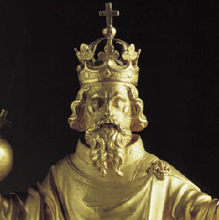
Charlemagne (768-814)
Most powerful ruler of Early Middle Ages
Einhard’s description
Succession dispute with Carloman and son

Slide 3
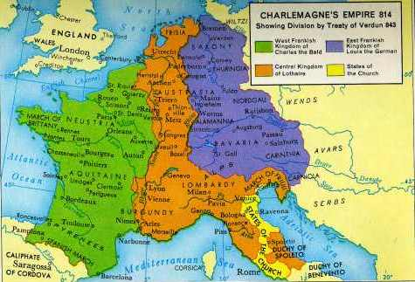
Charlemagne’s Empire
Numerous Conquests
  774: Lombards
  778: Spanish March
  785: Saxony
  788: Bavaria
  791: Carinthia
Largest empire since Rome
843: Treaty of Verdun

Slide 4
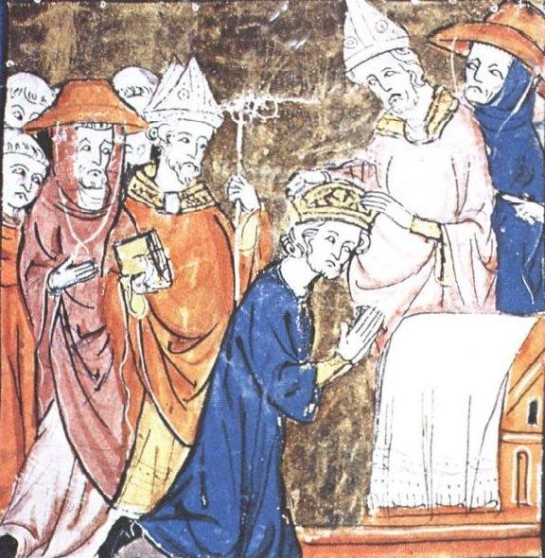
“Emperor of the Romans”
799: rebellion against pope in Rome
12/23/800: Charlemagne clears pope
12/25/800: coronation
Political considerations

Slide 5
Carolingian Renaissance
Charlemagne as supporter of the Church
  Duty to educate clergy
  Duty to promote a uniform Bible
Alcuin of York (735-804)
  Ran palace school for royal family, nobles
  Schools, libraries throughout empire
  Increased literacy among clergy
  Copying manuscripts

Slide 6
“The First Europe”
Charlemagne’s reign—definite fusion of elements of medieval civilization
  Roman vision of united empire
  Customs and traditions of Germanic peoples
  Christendom—Christian civilization

