Slide 1
Western Civilization to 1500
Lecture 31: Christianity in Early Medieval Europe

Slide 2
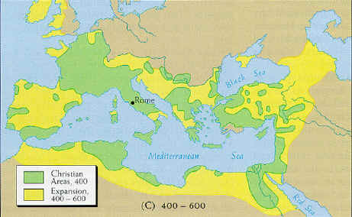
Christian Evangelism
Continuing missionary efforts ➔
Progress beyond Roman Empire
Armenia

Slide 3
Celtic Christianity
St. Patrick and Ireland
Importance of monasteries
  Abbots’ authority
  Evangelism
    St. Columba
    Iona
    Lindisfarne
  Scholarship (“saving civilization”)

Slide 4
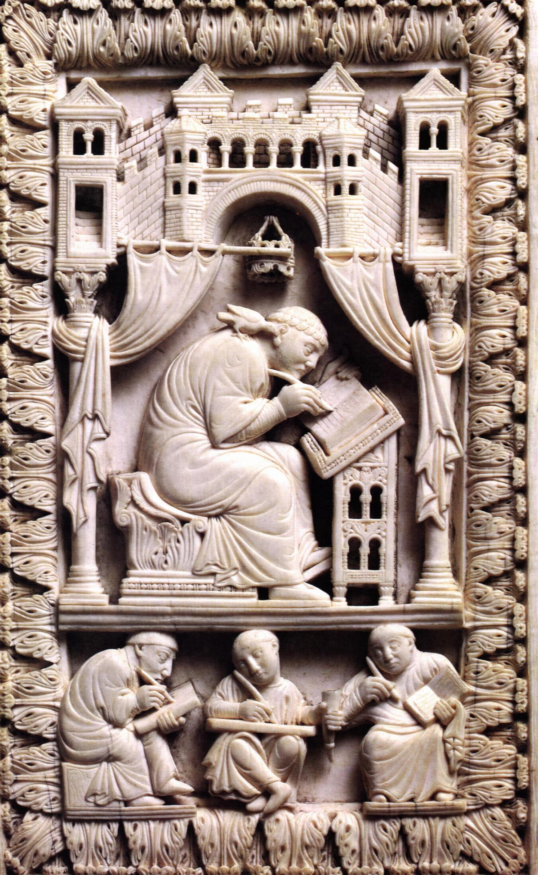
Gregory the Great
Pope 590-604
Pressed claims of Petrine supremacy
Accumulated political power
Alliance with Franks

Slide 5
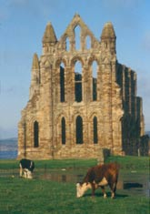
Synod of Whitby (663-664)
Romans vs. Celts in Britain
  Celtic evangelists moving southward
  St. Augustine of Canterbury
  Romans moving north
Argument over Easter
Petrine supremacy basis of decision

Slide 6
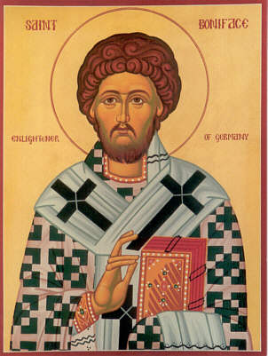
More Evangelism
England as missionary base
St. Boniface (680-754)
  Mission to Bavaria, Thuringia
  Helped end human sacrifice

