Slide 1
Western Civilization to 1500
Lecture 30: Barbarian Kingdoms of Early Medieval Europe

Slide 2
Medieval Foundations
Christianity
Roman Empire
Germanic Tribes

Slide 3
Germanic Society
Central role of the family
Family structure and marriage (Tacitus)
Personal nature of legal system
  Blood feuds
  Wergeld – “money for a man”
  Compurgation and ordeal
Impersonal nature of legal system—custom and law superior to leaders

Slide 4
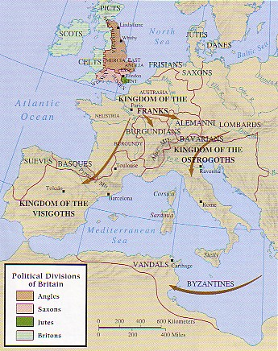
New Barbarian Kingdoms
Italy
  Ostrogoths
  Lombards
Spain – Visigoths
England – Anglo-Saxons
Religious problems (Arianism)

Slide 5
Boethius (480-524 A.D.)
Advisor to King Theodoric
Implicated in a conspiracy and jailed
Authored Consolation of Philosophy
Blending of Christian and pagan ideas
  God as a philosophical concept
  Echoes of both Plato and Aristotle
Big influence over next 1,000 years
Notes:
Like a set of revolving concentric circles, the simple center is the mind of God. The further out one is removed from the center the greater the level of Fate. The closer to the center the freer one is from Fate and the closer one seeks the center of things.

Slide 6
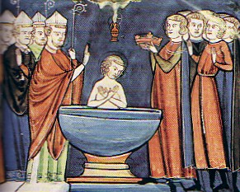
Franks—Merovingians (1)
Clovis (482-511)
Conversion to Orthodox Christianity
Expansion
Primitive feudalism, “counts,” & bishops
Latin/German fusion

Slide 7
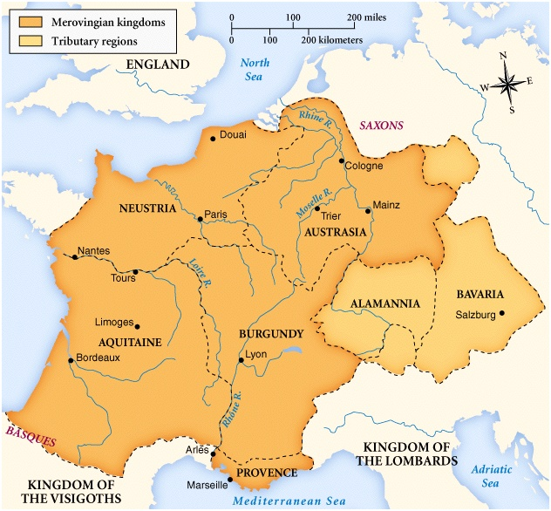
Franks—Merovingians (2)
Divisions of empire
Fratricidal wars
Decline of rulers
Rise of “mayor of the palace” by 700

Slide 8
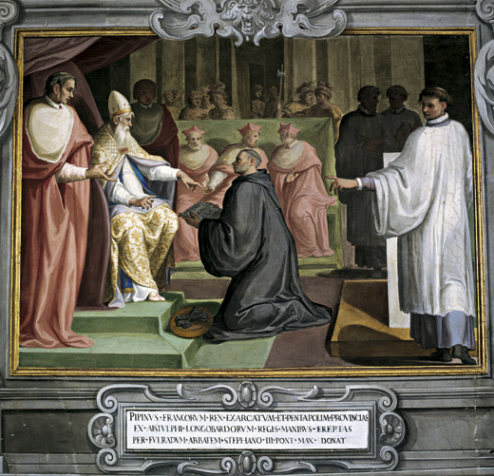
Franks—Carolingians
Charles Martel (mayor) and the Battle of Tours (732)
Pepin the Short
  Alliance with papacy
  Defeats Lombards
  Deposes last Merovingian and becomes king

