Slide 1
Western Civilization to 1500
Lecture 29: Early Islam

Slide 2
Roman-era Arabia
Arabs: Semitic-speaking people
Two major groups
  Urban dwellers (north)
  Bedouins
Religion
  Polytheistic
  Chief god: Allah (“God”)
  Sacred stones & the Ka’ba

Slide 3
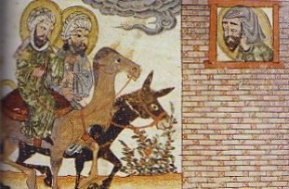
Muhammad (c.570-632)
Born in Mecca, merchant
610 – Visions
Moses➔Jesus➔Mu-hammad
Quran (Koran)
Islam, Muslims

Slide 4
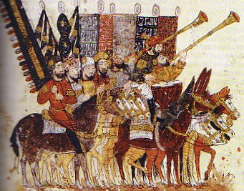
The Five Pillars
Confession of faith
Ritual prayer
Alms tax
Ramadan fast
Pilgrimage to Mecca

Slide 5
Islamic Sacred Writings
Quran/Koran – Allah’s dictation to Muhammad
Hadith – Muhammad’s teachings
Shariah – law code derived from the sunna (what Muhammad approved)

Slide 6
Spreading the Faith
Rejection in Mecca
622 – Hegira (flight to Medina)
Conversions in/near Medina
630 – Return to Mecca
Rapid conversion of Arabia
632 – Muhammad dies

Slide 7
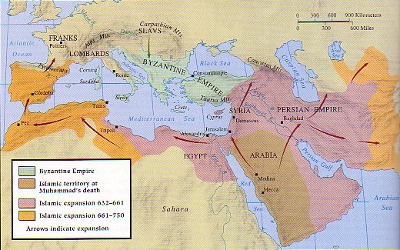
Expansion of Islam
Jihad – “striving in the way of the Lord”
Outward expansion
  636 – Battle of Yarmuk
  640 – Syria
  642 – Egypt, North Africa

Slide 8
Expansion of Islam (2)
More conquests
  650 – Persian Empire
  711 – Spain
Expansion stopped
  718 – Byzantines
  732 – Battle of Tours
Internal division of Christianity

Slide 9
Leadership
“Rightly guided” caliphs
Ali vs. Muawiyah
  661 – Death of Ali
  Shi’a vs. Sunni
Umayyad Caliphate (661-750)

